Slide 1
Cyanobacteria as the ultimate photo-catalysts of the conversion of CO₂ into chemical commodities and liquid fuel, driven by either sunlight or electricity“
Klaas J. Hellingwerf
Swammerdam Institute for Life Sciences

Slide 2
Starting points:
Electricity will become a/the major renewable energy source
Solar panels and wind turbines will be the primary producers
Fuel in liquid/solid form and chemical commodities will also be needed in 2050
Mankind urgently needs to “close” the carbon cycle

Slide 3
Global Carbon Cycle
(plants, bacteria)
CO₂ + H₂O
Cells + O₂
→ energy
(animals, bacteria)
O₂
CH₄
Earth’ surface
fossil fuels

Slide 4
Relevant considerations for a solution:
‘Artificial leaves’ vs. natural photosynthesis
Plant photosynthesis is rather inefficient (theoretical max.: 6 %; in practice often << 1 %
Solution should not create new problem (e.g. in food supply)
4th-generation approach necessary

Slide 5
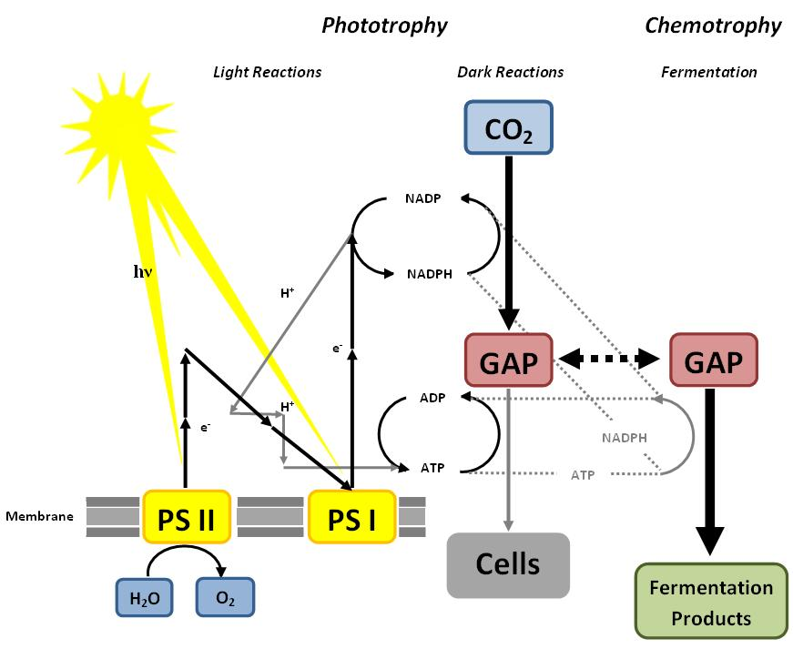
‘Photofermentation’
sugar

Slide 6
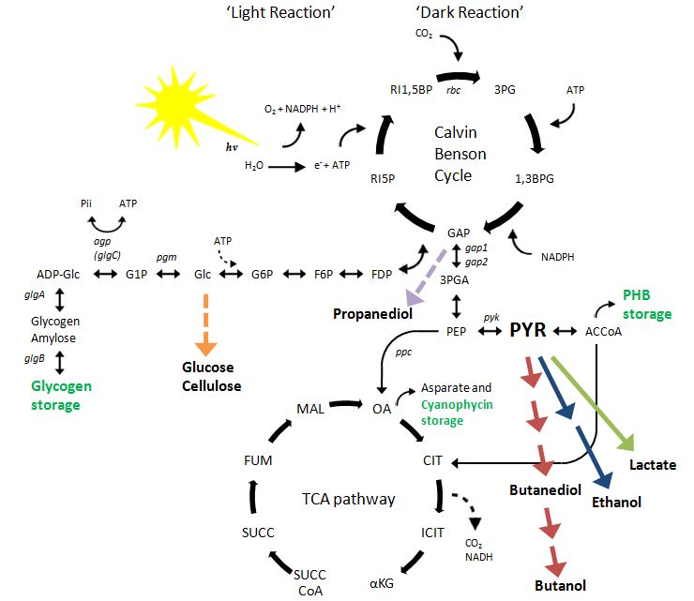
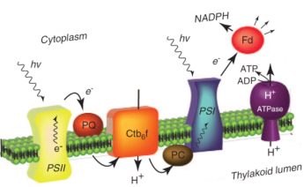
Photo-
fermentative
metabolism:
CO₂
Green:
storage compounds
Ethylene

Slide 7
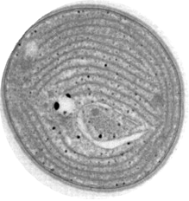
The ‘cell factory’ concept:
Heterologous Fermentation Pathway
O₂
pdc
adhII
hv
3 ATP
Calvin cycle
2 NADPH
Genome
Ethanol
TCA cycle
CO₂
Thylakoids
H₂O
CO₂ + H₂O C₂H₆O + O₂
(catalyst)

Slide 8
CO₂
LDH
LDH
Lactic acid

Slide 9
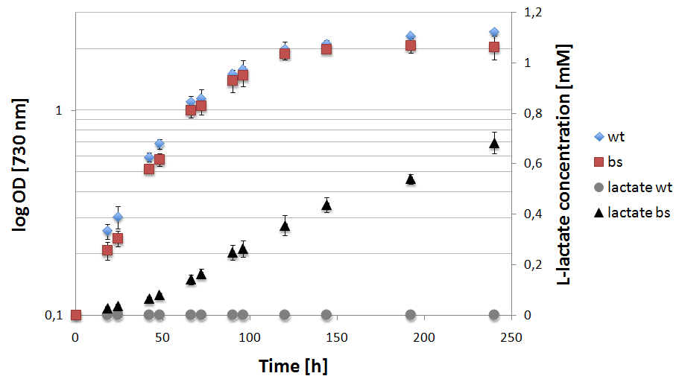
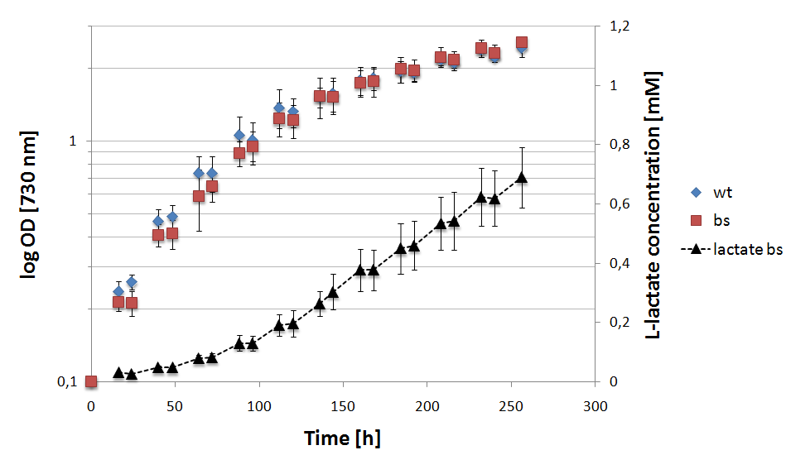
Lactate Production:
Notes:
Top left shows that our E. coli ldh did not yield in lactate production
Top right (and both figures at the bottom) are the usual B. subtilis ldh
Bottom left is the lactate production of three biological replicates growing in day / night rhythm, but sitting at slightly different light intensity spots
Bottom right is the mean of this three replicates, growth and lactate production in day / night rhythm.

Slide 10
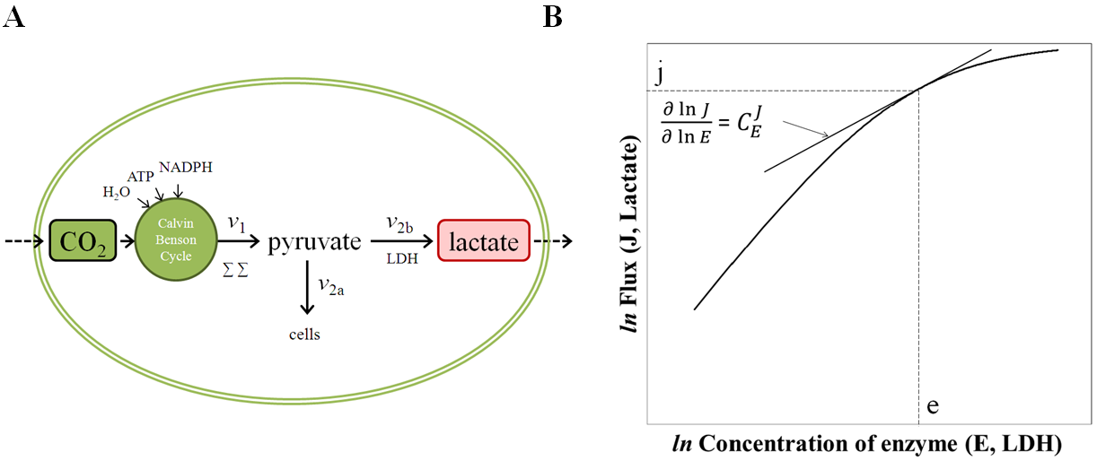
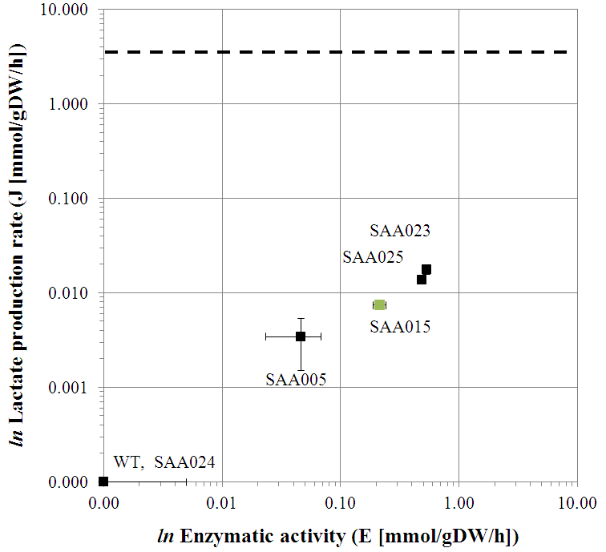
Sensitivity analysis of a solar-cell factory
Angermayr & Hellingwerf (2013) J Phys Chem B. DOI: 10.1021/jp4013152

Slide 11
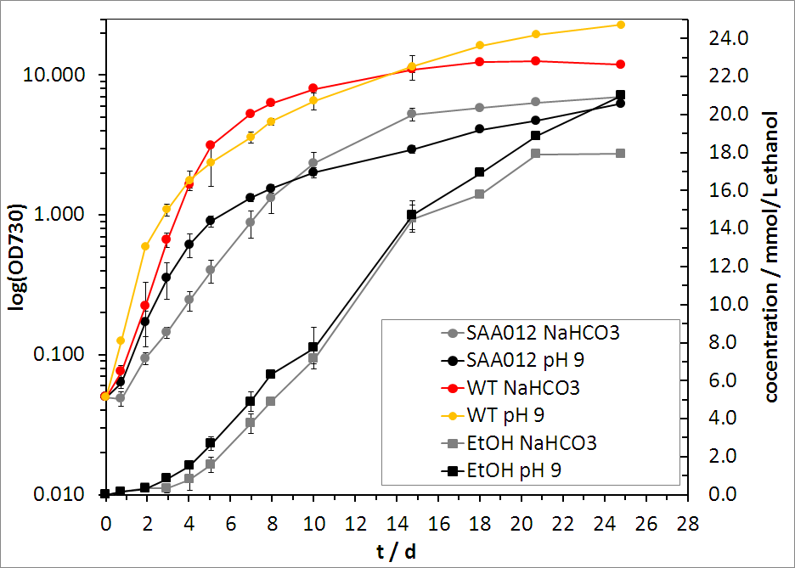
Ethanol production in strain SAA012
% of CO₂ into ethanol: 65%
CH₃CH₂OH

Slide 12
We can engineer with base-pair precision
We – and others – can make a wide range of products → Synechocystis is pluGbug for CO₂
For selected products > 70 % carbon partitioning achievable
Wild type cyanobacteria have a photosynthetic efficiency of > 10 %
Approach does not compete with food supply; does not create a minerals problem and has a limited water requirement as compared to traditional crops

Slide 13
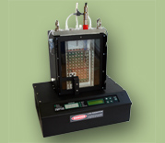

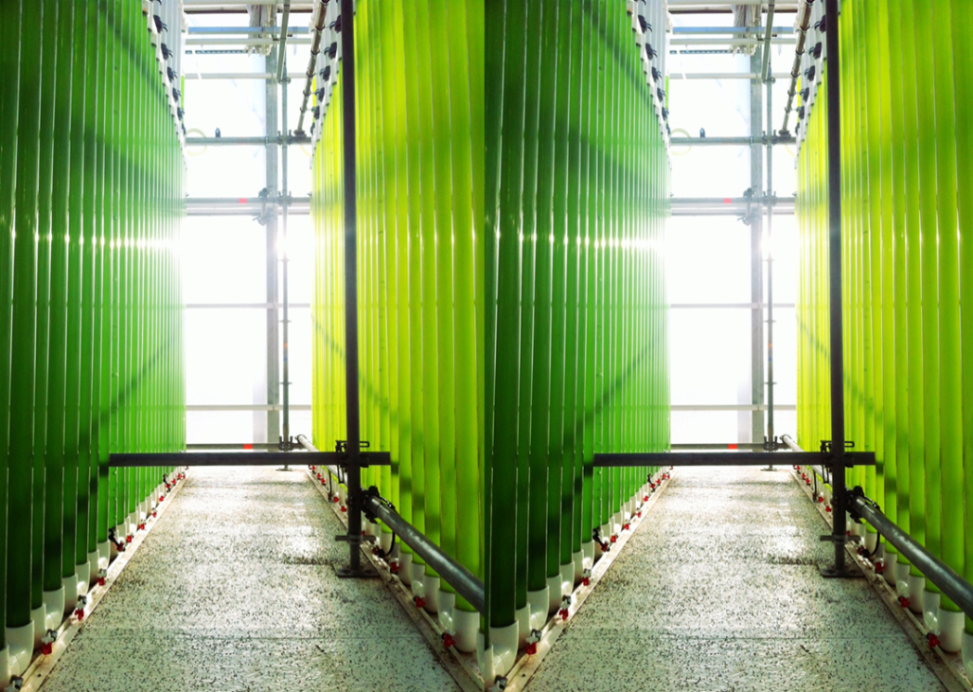
Pilot plant:

Slide 14
Assuming:
Efficiency of PV-cells: 50%
Efficiency of LEDs: 70%
Efficiency conversion 700 nm photons into fuel of 35%
Overall efficiency = 10%! => 0.1 MW/acre
In other words: A field full of solar panels on non-fertile soil would drive natural photosynthesis more efficiently than plant photosynthesis itself!

Slide 15
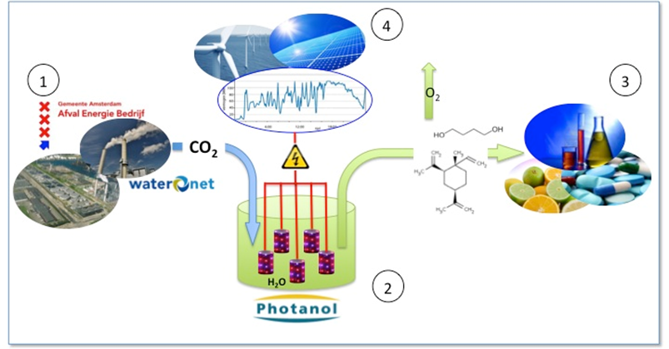
Design of 3-D LED-based solar reactors for value-added chemicals:
CO₂ producer

Slide 16
Conclusions:
The ‘race is on’ for economic exploitation between artificial leaves and designer cyanobacteria.
Already - using modestly modified cyanobacteria - the living organisms have taken the lead

Slide 17


living cel or plant
invested
energy
hydrolysis
energy
organel
heat
cel polymers
fermentation
heat
waste
intermediate product
product
conserved energy
CO₂

Slide 18
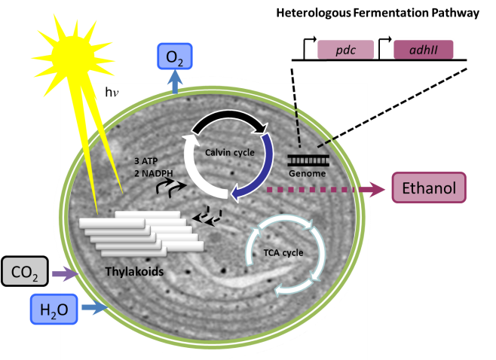
Cell factory for ‘photofermentation’
invested
energy
intermediair product
product
conserved energy
CO₂

Slide 19

A Synthetic Systems Biology approach:
A~CO₂
Challenge: make b/a > 1!!
4 mmol/gdw/h
B
CO₂
GAP
A
a
Promoter
D
b
E
E
+
cells
NH₄
Cassette
Ammonia availability is often used as a control parameter to regulate biomass formation
(V > 4 mmol/gdw/h!)
biofuel
product

Slide 20
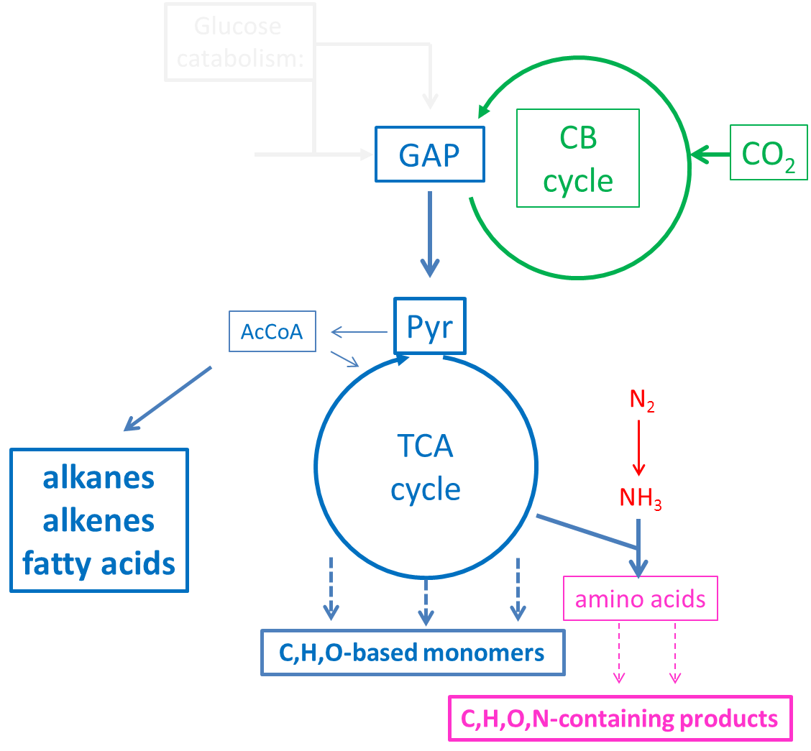
pluGbug
for CO₂

Slide 21
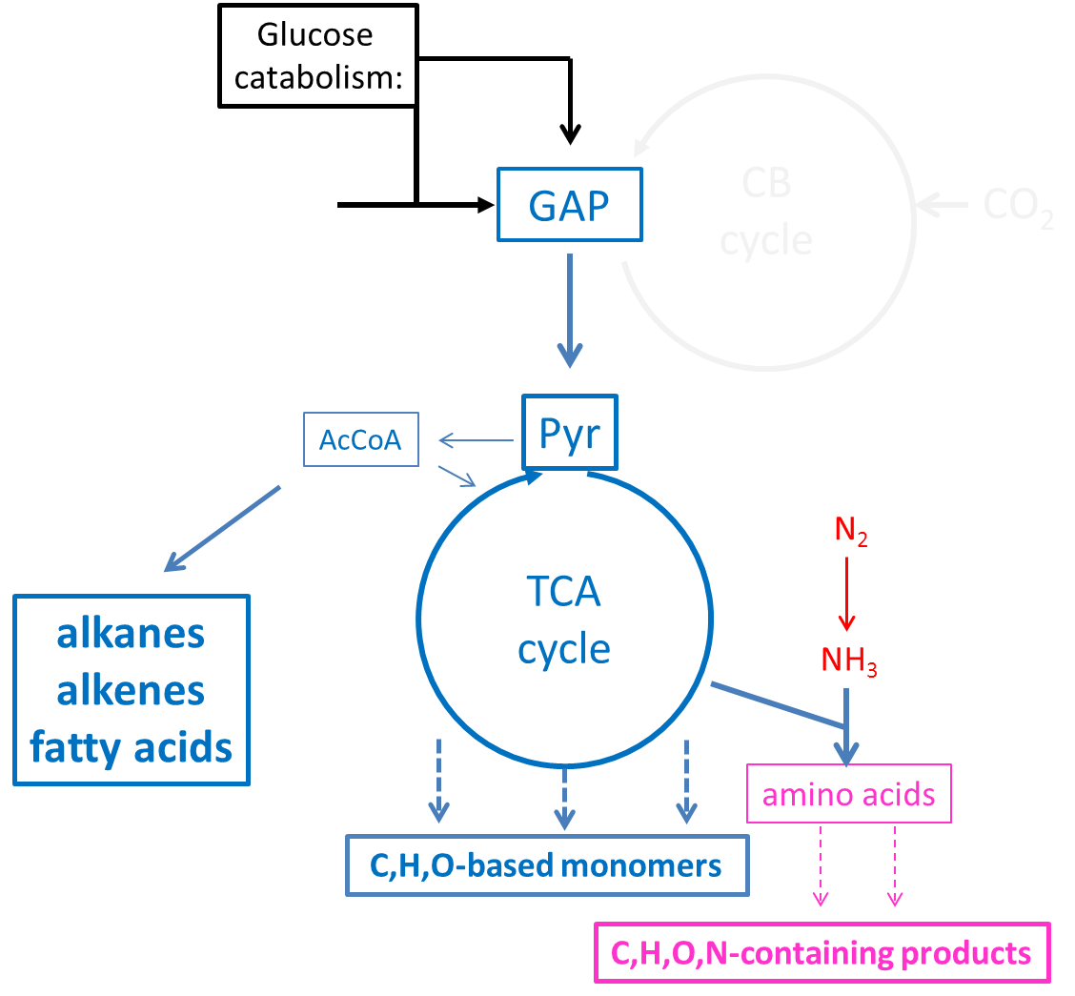
the pluGbug
concept

