Slide 1
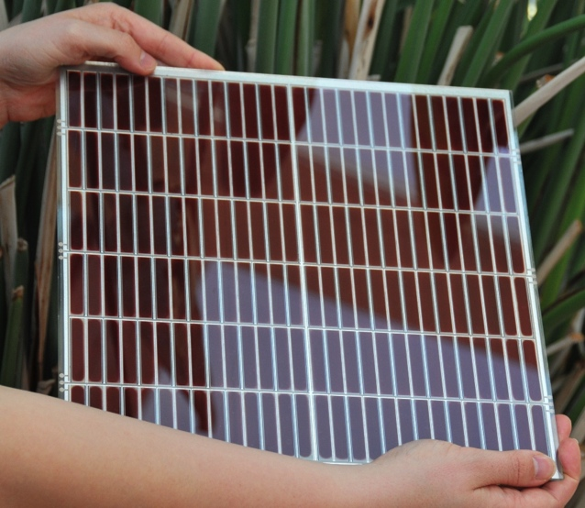
EASAC, KVA, Stockholm, September 19, 2013.
Hybrid Inorganic-Organic Photovoltaics, HI-OPV
Anders Hagfeldt, Uppsala University
Center for Molecular Devices
Fundamental research
Materials development
Up-scaling and process development
Dyenamo AB
www.dyenamo.se
Materials for solar cells and solar fuels research.
probe light
pump light
Mono-
chromator
LED
PIA
Signal analysis

Slide 2
Center for Molecular Devices (CMD)
KTH Stockholm
Organic Chemistry:
Licheng Sun
Yunhua Xu
Martin Karlsson
Erik Gabrielsson
Bo Xu
Haining Tian
Inorganic Chemistry:
Lars Kloo
Gunther Andersson
Mikhail Gorlov
James Gardner
Johnny Slätt
Muthuraaman Bhagavathi Achari
Viswanathan Elumalai
Majid Safdari
Jiajia Gao
Uppsala University
Physical Chemistry:
Anders Hagfeldt
Gerrit Boschloo
Erik Johansson
Leif Häggman
Nick Vlachopoulos
Susanna Eriksson
Marina Freitag
Lei Yang
Yan Hao
Dongqin Bi
Byung-wook Park
Hanna Ellis
Jinbao Zhang
Wenxing Yang
Meysam Pazoki
Kerttu Aitola
Valentina Leandri
Physics:
Håkan Rensmo
Rebecka Lindblad
Johan Oscarsson
Azhar Zia
Swerea IVF, Mölndal
Henrik Pettersson
Tadeusz Gruszecki
Jan Preisig
Elis Carlström

Slide 3
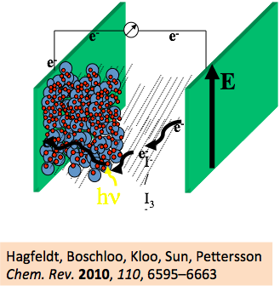
Mesoscopic Dye-sensitized Solar Cells (DSC)
– a versatile and complex molecular system
Brian O’Regan and Michael Grätzel
Nature, 1991, 353, 7377. 7% efficiency.
> 10’000 citations
The paradigm shift by O’Regan and Grätzel in 1991 meant that we can prepare efficient solar cells without using well-defined and ultrapure (expensive) semiconductors. Instead we can design molecular and nano-structures and interfaces with optimal electron transfer kinetics and rely on diffusion as charge transport mechanism -
a lot of chemistry to do!

Slide 4
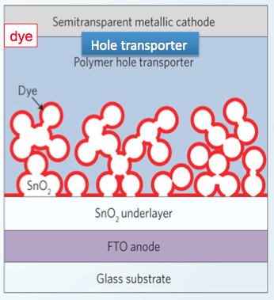
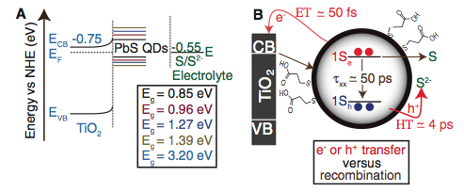
DSC is a versatile (chemical) device!
Water splitting devices
Mesoscopic solid-state solar cells
Perovskite solar cells
-
n-type DSC
p-type DSC
+
Tandem Cells
Q-dot sensitized solar cells

Slide 5
Some DSC facts
Power conversion efficiency (PCE)
laboratory cells: 13.0 % (EPFL), modules: 9.9 % (Sony).
Perovskite solar cells. 14.1% (certified, EPFL), about 15% (EPFL, Oxford)
Outdoor performance - production cost per kWh an advantage for DSC:
a 10 % PCE rated DSSC module produces over one year the same amount of electricity as 14-15 % rated Si module (Sony).
Electricity from ambient and indoor light:
DSC outperforms all competitors
stability
> 20 years outdoors accelerated testing (Dyesol, Fujikura …)
energy pay back time:
< 1 year (3GSolar and ECN life cycle analysis

Slide 6
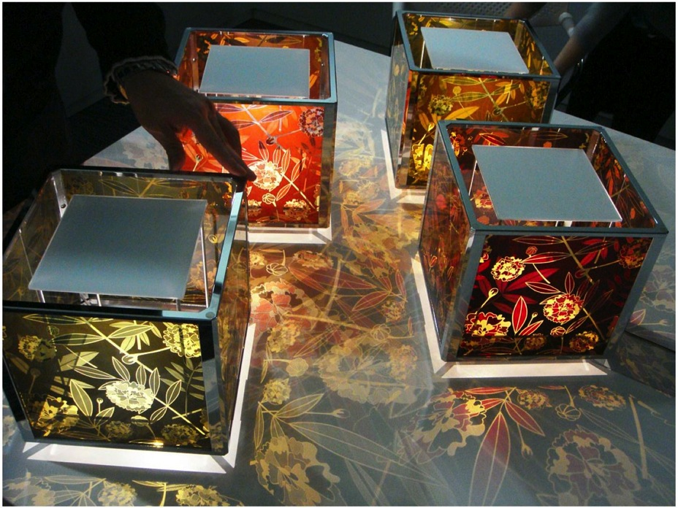
HANA AKARI
FLOWER LAMP
(SONY)
Design: Colours and Transparency
Product Integration
6
Notes:
6

Slide 7
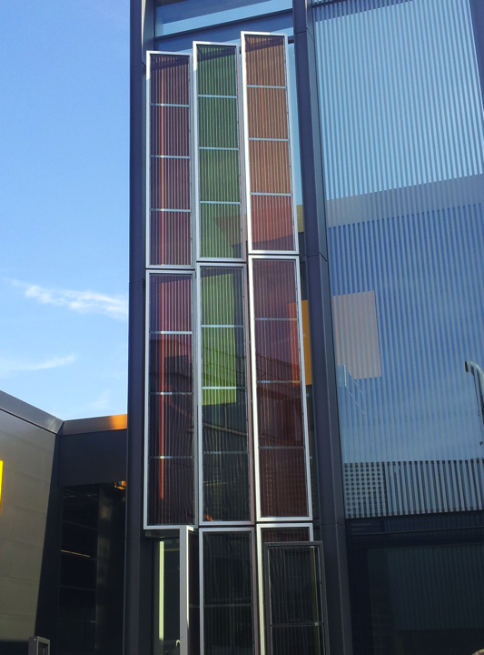
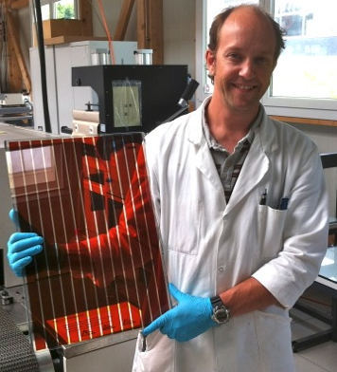

Façade for the new congress hall at EPFL, Lausanne
Building Integration

Slide 8
How to compete with silicon?
  Production cost of 50 $/m² with 15 % module efficiency gives 0.33 $/Wpeak
  Cell efficiencies > 15%?
  - Two recent breakthroughs from the DSC community
  - The hunt for the half volt –replacing the I⁻/I₃⁻ redox couple
  - Perovskite solar cells

Slide 9
Where are the internal losses?
- the hunt for the half volt
e⁻
e⁻
e⁻
Dye-sensitized Solar Cells
e⁻
e⁻
e⁻
I⁻ / I₃⁻
TCO
TiO₂
Dye
Electrolyte
Can a 2-electron redox couple be replaced by a 1-electron couple?
A problem for almost 20 years

Slide 10

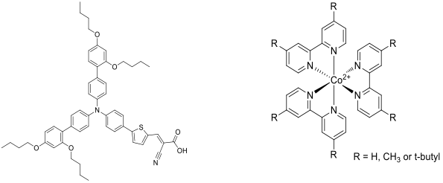
In 2010 we introduced the ’marriage’ between a blocking dye and Co-complex redox systems
D35
Feldt, Gibson, Gabrielsson, Sun, Boschloo, Hagfeldt,
J. Am. Chem. Soc. 2010, 132, 16714.

Slide 11
Best result with Co-mediator without steric groups:
- Electron lifetimes the same for all Co-mediators
- Mass transport best for Co-mediator without steric groups
- Suitable for indoor light
 | V_{oc} / V | J_{sc} / mAcm⁻² | FF | η / %
[Co(bpy)₃]^{n+} 1 sun 1/10 sun 250 lux | 0.92 0.85 0.7 | 10.7 1.12 18.5 x 10⁻³ | 0.68 0.76 0.8 | 6.71 7.15
0.22 M Co-red, 0.033 M Co-ox, 0.1 M LiClO₄ and 0.2 M 4-tert butylpyridine (TBP) in acetonitrile

Slide 12
The World Record DSC is Based on Porphyrine Dye and Co-complex Redox Electrolyte
Grätzel and co-workers: The SM315 porphyrin
reaches a record efficiency of 13% :

Slide 13
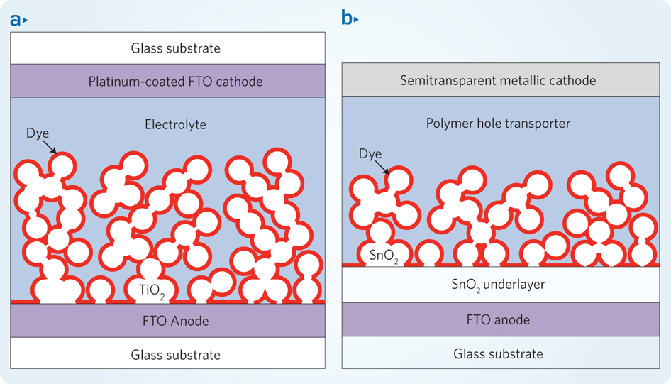
Solid-State DSC
DSSC using redox electrolyte
DSSC using hole transport material
Redox electrolyte PCE
Solid hole conductor PCE
dye
light harvester
dye or pigment film
TiO₂
TiO₂

Slide 14
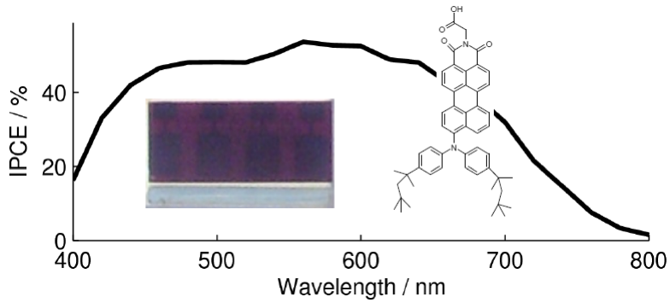
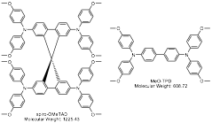
Solid-state DSSC
In collaboration with BASF SE and EPFL.
ID176
spiro-OMeTAD
ID176 + spiro-OMeTAD
Works well for ssDSSC (> 3%), but very poor in liq-DSSC (<1%)
Cappel et al. J. Phys. Chem. C, 2009, 113, 14595

Slide 15
Why does ID176 work in solid and not in liquid DSC?
A.
Ultrafast regeneration of the oxidized dye.
Reductive quenching mechanism.
3
Reduced Dye
CB
Excited state
B.
Injection in surface states?
1
Spiro-OMeTAD
2
ps regeneration
Cappel et al. JPC C, 2011, 115, 4345

Slide 16
Reductive quenching may allow for electron
conduction through a dye/ETA layer
*ETA = Extremely Thin Absorber
-
-
Ultrafast regeneration by
solid-state hole conductor
-
-
+
Dye/ETA layer

Slide 17
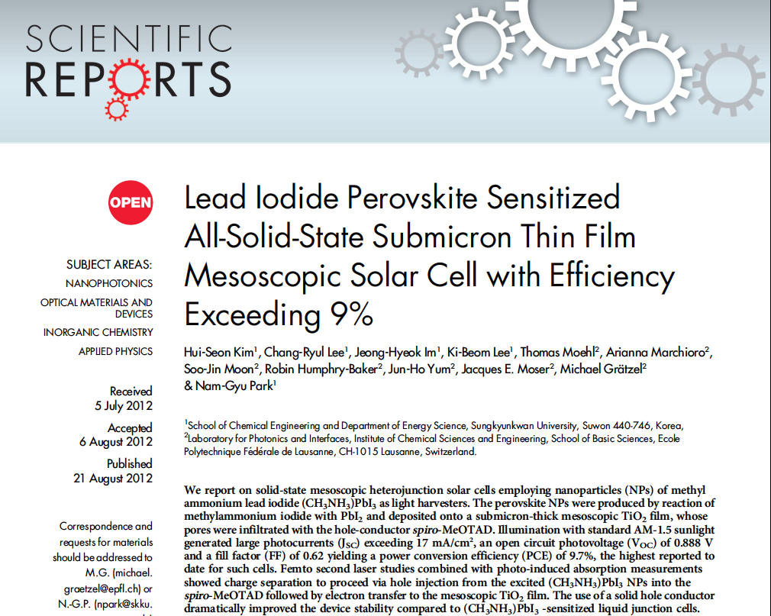
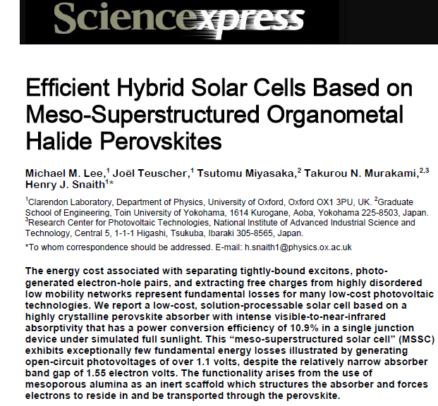

Slide 18
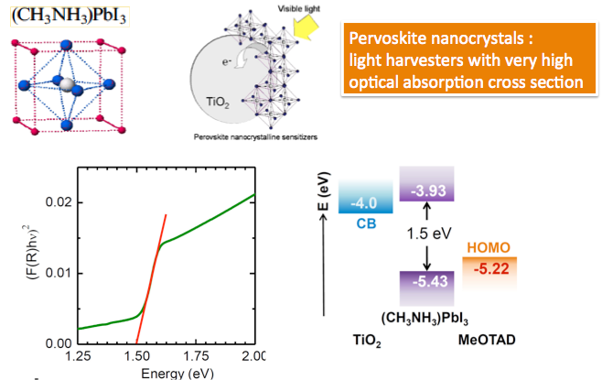
Perovskite Solar Cells - An Organic-Inorganic Hybrid

Slide 19
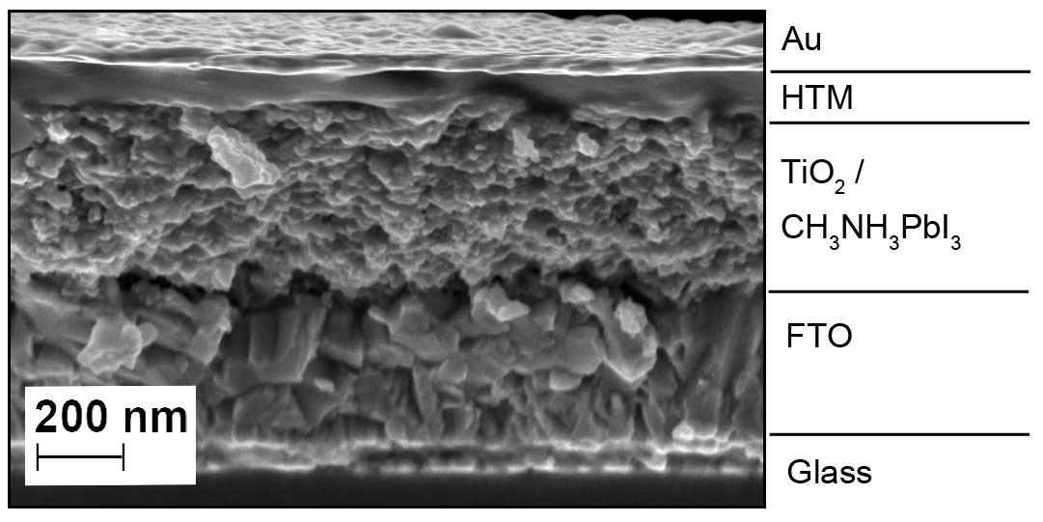
Cross sectional SEM of a mesoscopic p-i-n solar cell with
TiO2/perovskite as light harvester
P
i
nanocomposite
n
Certified record efficiency of 14.1% by Grätzel and coworkers.

Slide 20
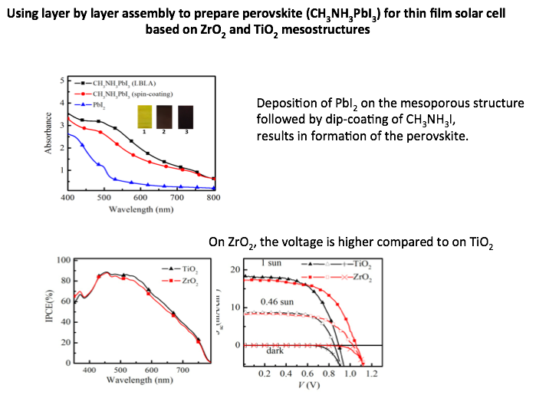
Our latest perovskite results from CMD
RSC Adv., 2013, DOI: 10.1039/C3RA43228A
Best efficiency, 10.8%, obtained with ZrO2 as scaffold.

Slide 21
Several open fundamental questions
Perovskites work on insulating substrates like ZrO₂ and Al₂O₃. Is electron injection necessary?
Works without the p-type hole conductor (direct contact between Au and perovskite).
Low exciton binding energy (30 – 50 mV). Selective contact device?
Reproducibility (morphology of perovskite vs preparation conditions)
Stability: for a single crystal perovskite there is e.g. A phase transtion at 55 ⁰C (from tetragonal to cubic)
Possibilities to replace Pb?
Opens up 3rd Generation concepts?

Slide 22
The possibilities for efficiencies >15%
Cf. O’Regan et al. Chem. Mater.
23 (2011) 3381
Absorber with band gap of 1.6 eV (ca. 800 nm)
0.25V for driving force for injection and regeneration
Possible efficiency:
V_{oc}=1.1V, J_{sc}= 22 mA/cm², FF = 0.73.
PCE= 17.66 %
Module efficiencies of 15% possible
- 0.6
0.25 eV
- 0.35
1.6 eV
0.75
0.25 eV
1.0
V vs NHE
Cf. Grätzel et al. Nature Comm.
3 (2012) Art. Nr. 631

Slide 23





Financial Support - CMD
Knut & Alice Wallenberg Foundation
Sony Deutschland GmbH
Merck, Germany

