Slide 1


Nanowires with promise for high efficiency photovoltaics
M.T. Borgström,
magnus.borgstrom@ftf.lth.se
NW Doping
Total control over axial and radial NW growth
NW solar cells

Slide 2
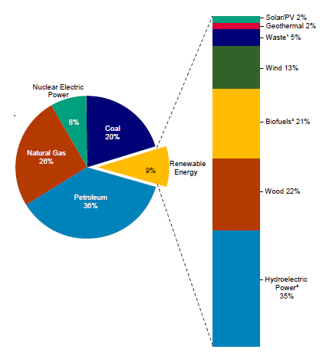
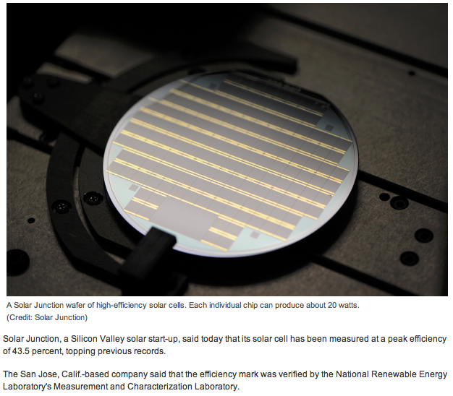
World record efficiency solar cell
US energy information
administration 2012
Solar Junction: III-V multi junction solar cell

Slide 3
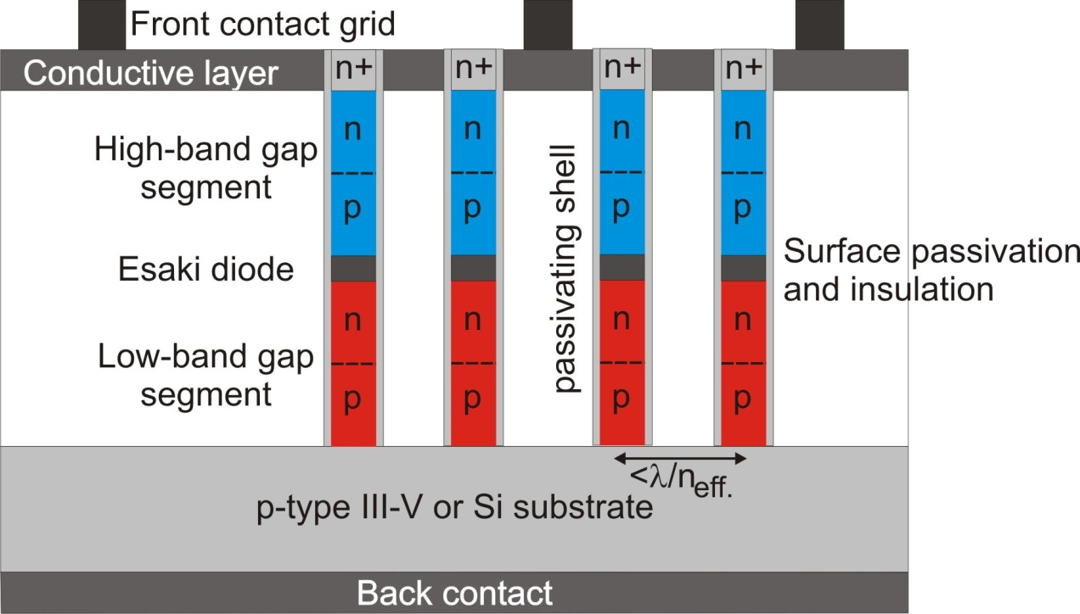
AMON-RA (FP7 214814)
Lund University
Fraunhofer Institute for Solar Energy Systems
University of Kassel
Sol Voltaics AB
Johannes Kepler University Linz
Technical University of Denmark

Slide 4
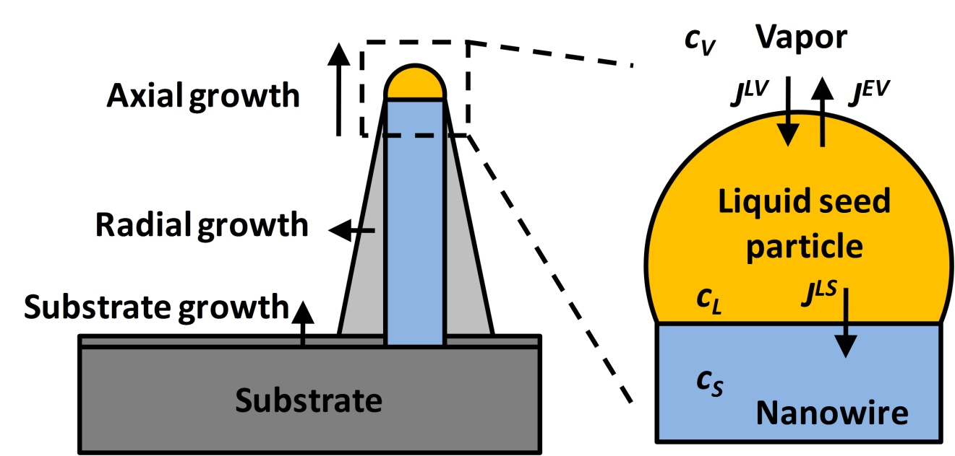
Impurity doping in nanowires
Particle assisted growth:
Low temperature (400-500ºC) MOVPE 600-700ºC
Complex growth dynamics
[111] growth direction
crystal structure
Solubility
Segregation coefficient
Characterisation:
Chemically (EDX)
Electrically (Field effect)
Optically (PL)
Atom probe
Hall measurements
Wallentin, Borgström JMR 2011

Slide 5
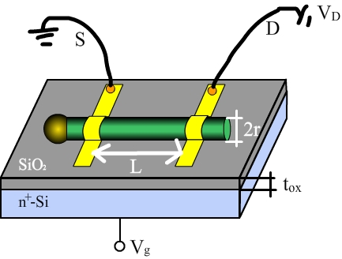
Evaluate doping – nw-FET
Drude model, σ =nqμ
Carrier concentration, n = doping concentration
Mobility (µ) extracted from gate-sweeps
Conductivity (σ) extracted from I-V
n-type

Slide 6
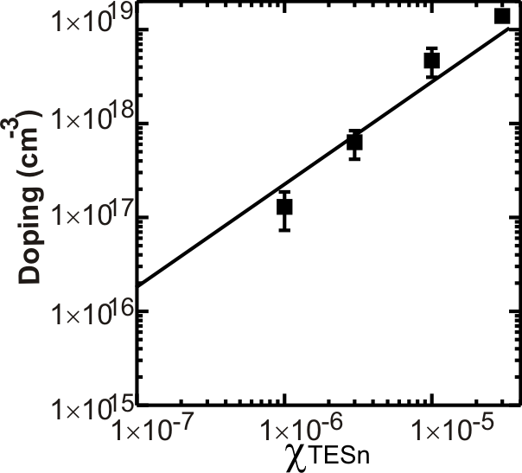
TESn for n-doping
(Sn:InP ionization energy 5.9 meV)
Gate voltage dependent action - n-type
transconductance + IV (ohmic contacts)
threshold voltage (non ohmic contacts)
Borgström et al, Nanotechnology, 2008

Slide 7
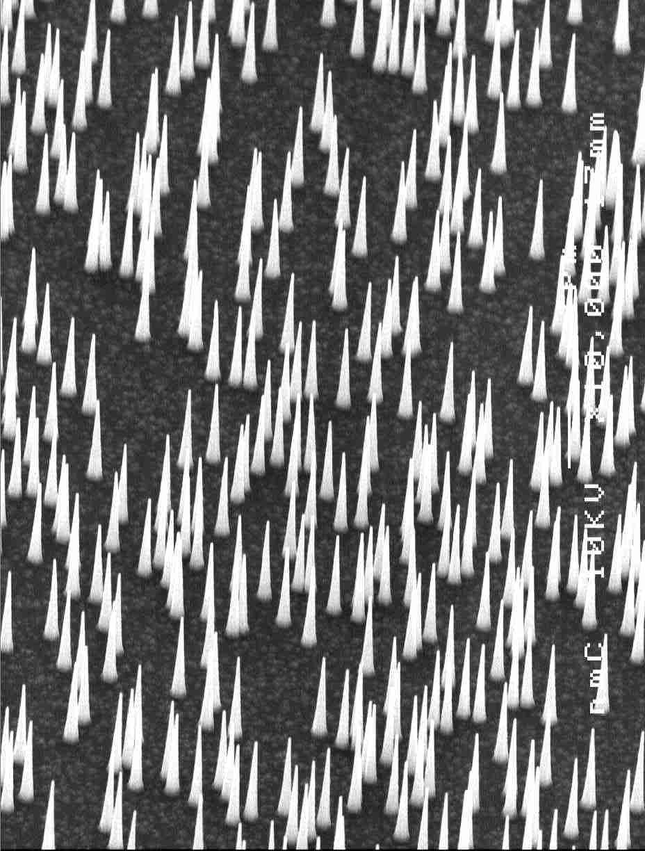
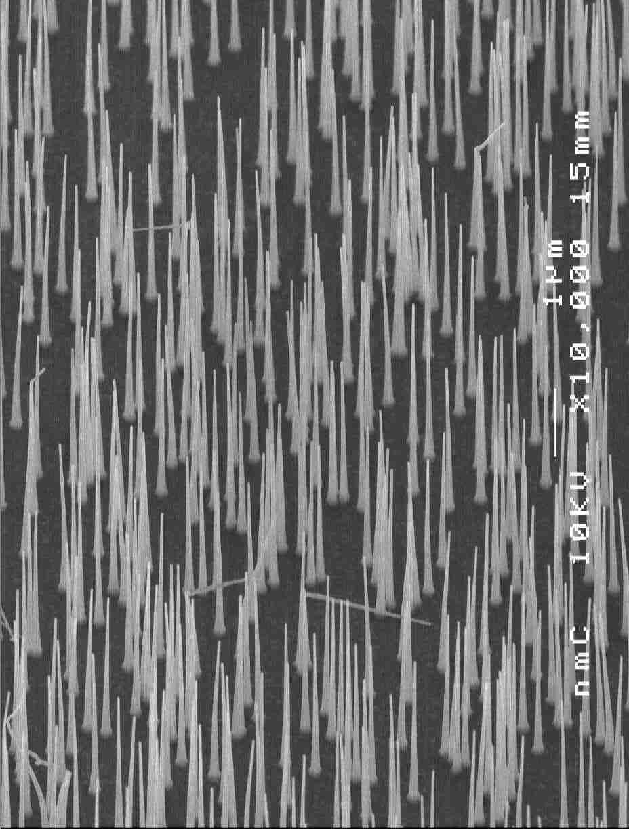
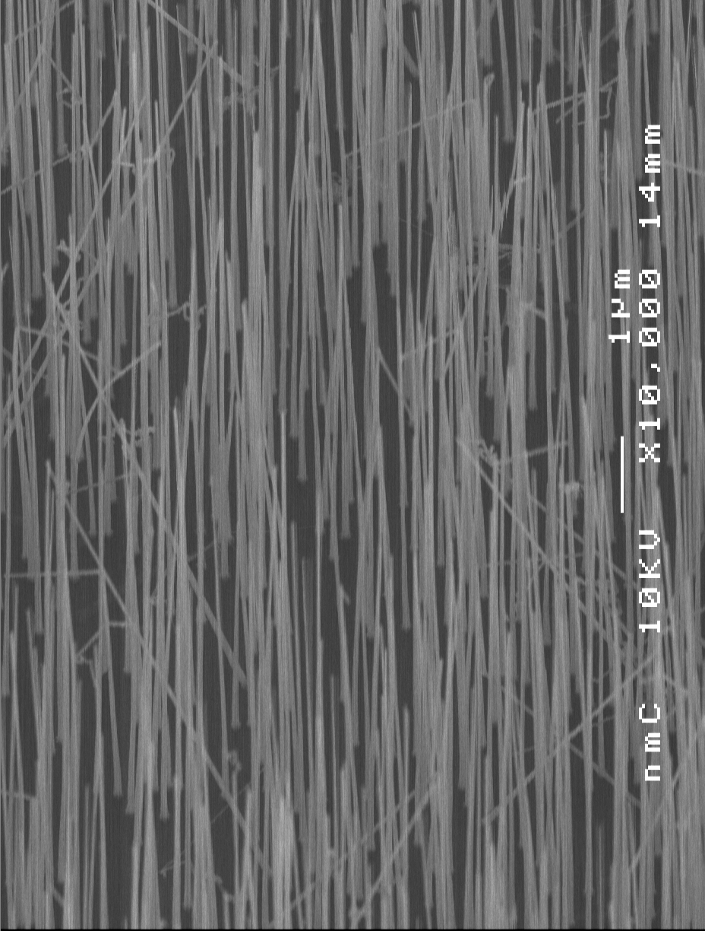
Dimethylzinc for p-doping (Zn:InP ionization energy 35 meV)
X_{DMZn}=1e-6, 20min
X_{DMZn}=1e-5, 20min
X_{DMZn}=5e-5, 20min
Gate voltage dependent action - p-type
DMZn enhances the nanowire growth rate and suppresses side wall growth
Nucleation problems for high dopant precursor molar fraction
Borgström et al, IEEE J Sel Top Quant 2011

Slide 8
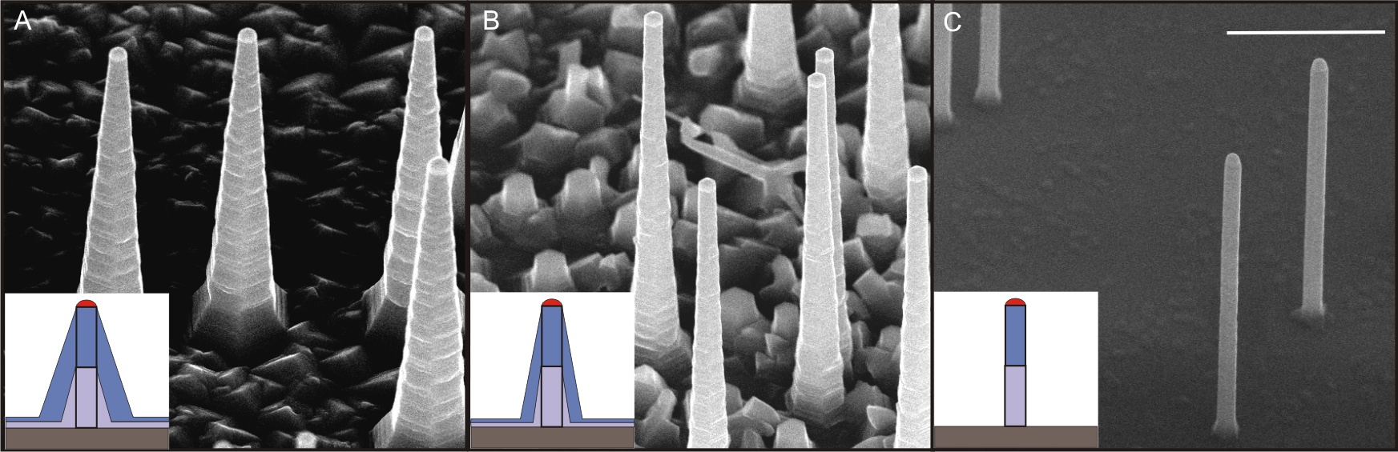
Decoupled axial and radial growth
Increasing in-situ HCl molar fraction
80 nm aerosol particles
TMI, PH3, HCl
Growth temperature 450°C
Borgström et al, Nano Research, 2010

Slide 9
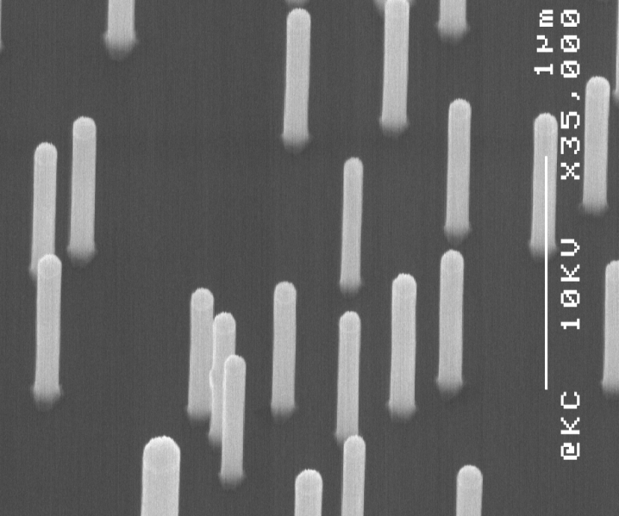
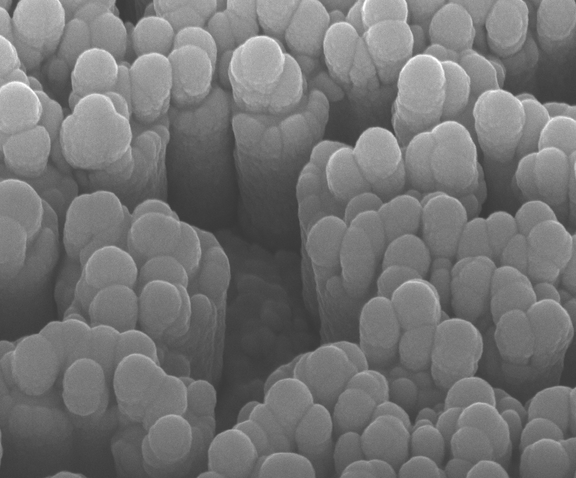
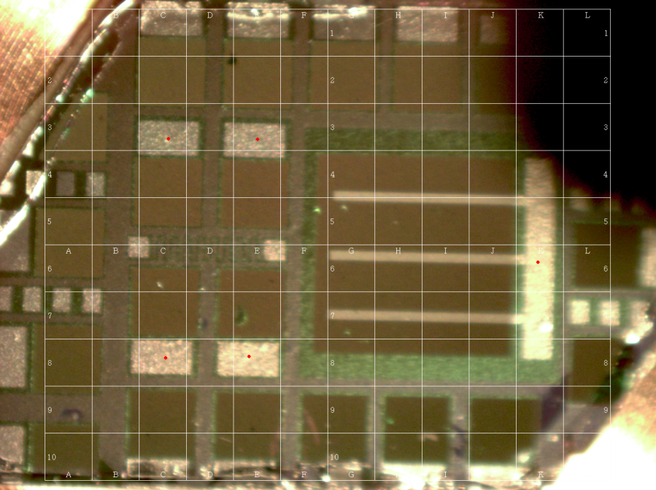
NW solar cell fabrication
1x1 mm devices
ITO
InP:n
Di-
electric
InP:p
InP:p+
Borgström et al, IEEE J Sel Top Quant 2011

Slide 10
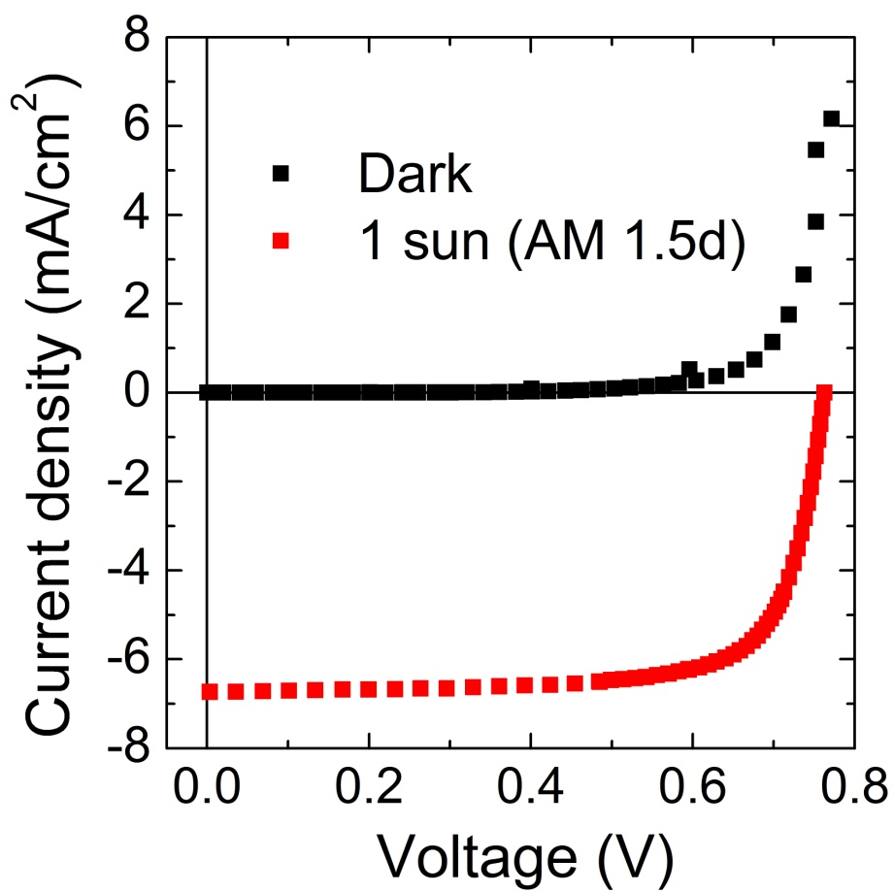
Photocurrent measurements
Efficiency 3.8% (1 sun, AM 1.5)
Fill factor 74%
V_{oc} = 0.75 V
Excellent light capture despite
low density (are fill factor 3%)
5 times more efficient per active
surface area than thin film InP cell
Current density through NW
about 3 times higher than in record
multi junction solar cells.

Slide 11
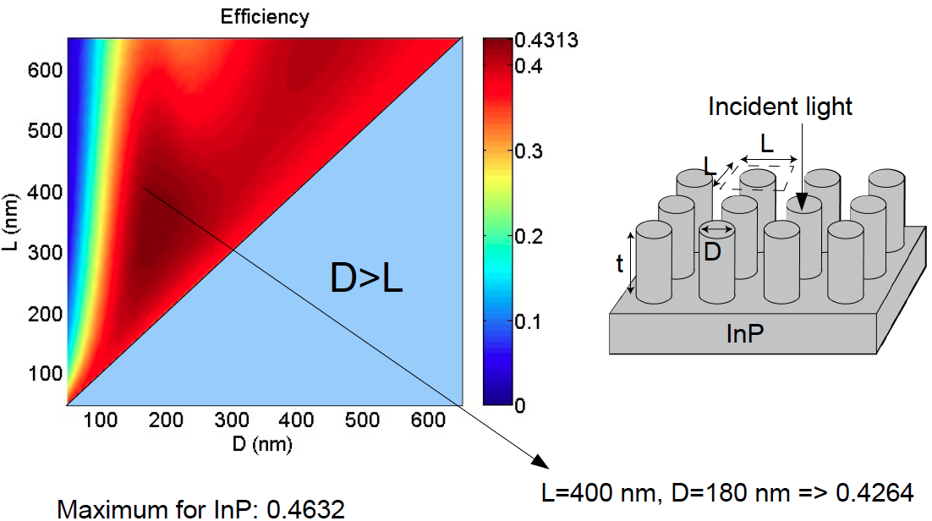
Modeling ideal structures
Anttu & Xu,
Optics Express, 2013
t=2000 nm

Slide 12
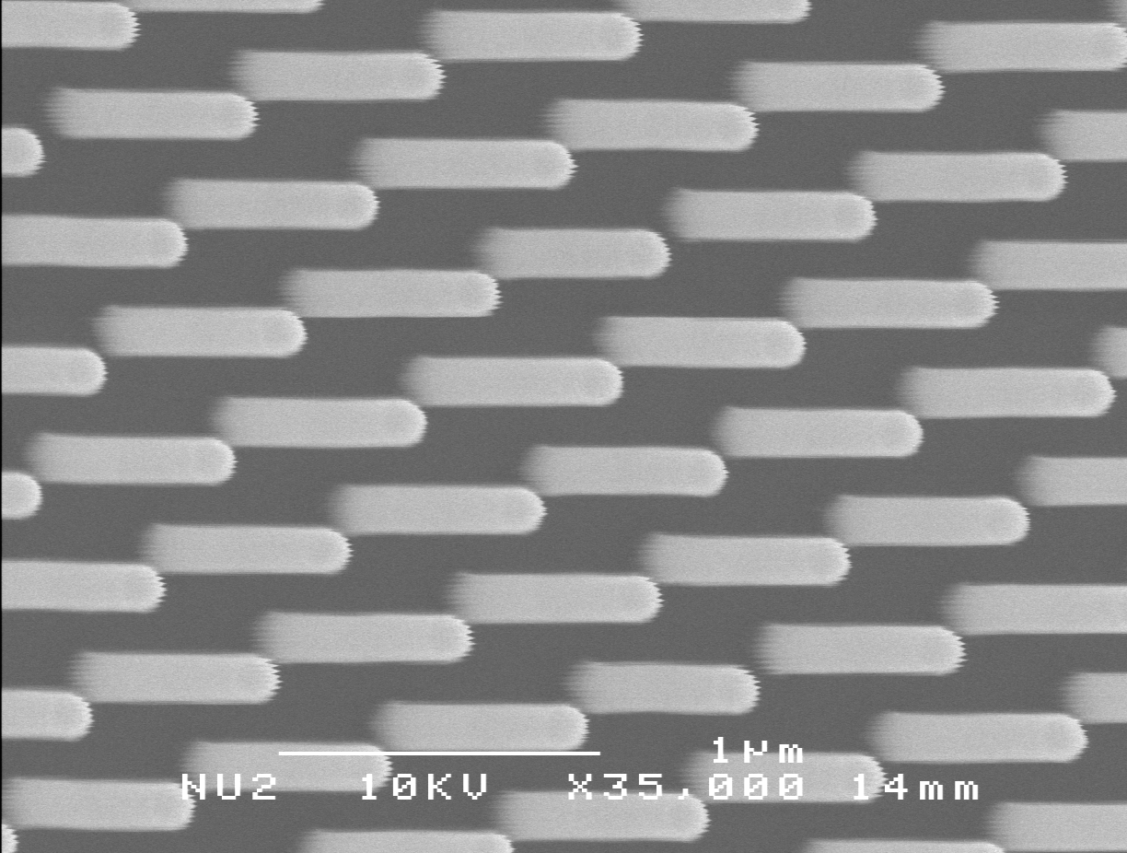
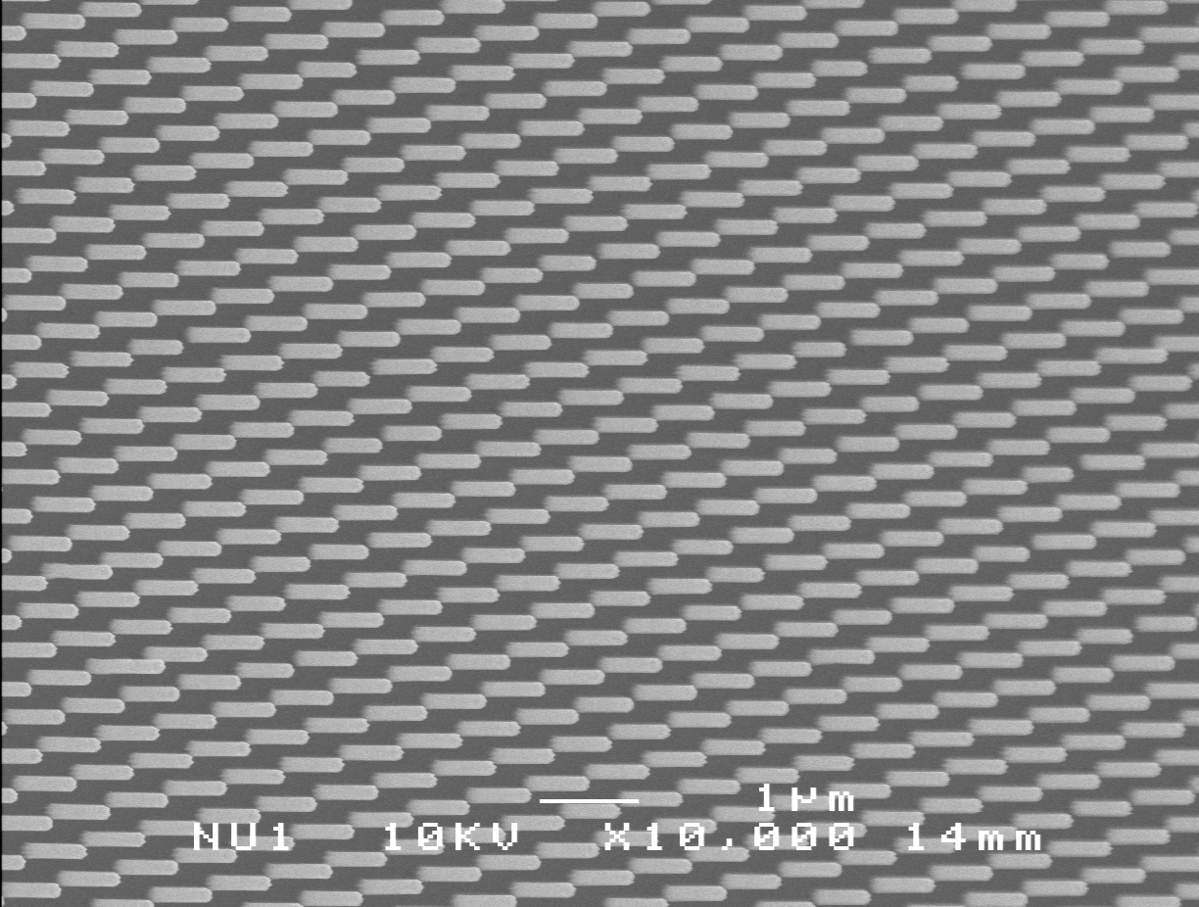
Nano imprint lithography for large scale economically viable patterning

Slide 13
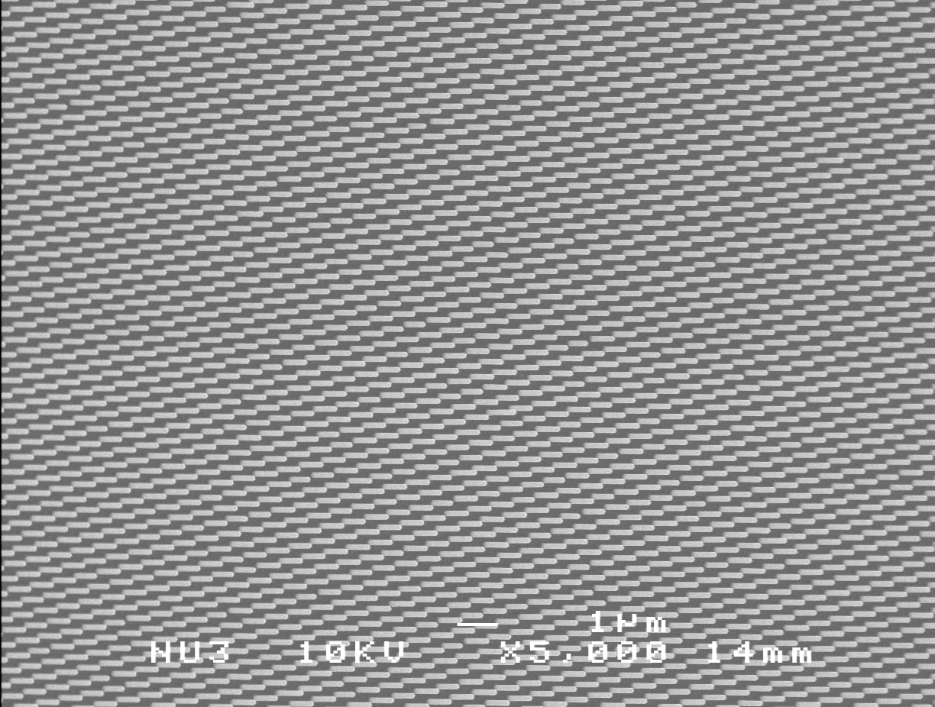
Nano imprint lithography for large scale economically viable patterning

Slide 14
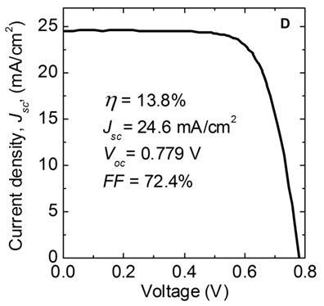
PV performance
NW surface fraction 12%
Wallentin et al, Science 2013

Slide 15
Summary
NWs promising for high efficiency solar energy harvesting
NW Doping
Nano imprint lithography for NW growth
Nanowire based photovoltaics

Slide 16
Acknowledgements
J. Wallentin, N. Anttu, D. Jacobsson, M. Heurlin, H. Q. Xu, L. Samuelson, K. Deppert
Solid state physics, Lund University
D. Asoli, M. Huffman, I. Åberg, M. Magnusson
Solvoltaics AB, Lund
M. Ek, L. R. Wallenberg
Polymer & Materials Chemistry/nCHREM, Lund University
J . Persson, J. Wagner
Center for Electron Nanoscopy, Technical University of Denmark
D. Kriegner, T. Etzelstorfer, J. Stangl, G. Bauer
Johannes Kepler University Linz
P. Kailuweit, G. Siefer, F. Dimroth
Fraunhofer institute for solar energy systems, Freiburg
EU project AMON-RA (FP7 214814)
EON International Research Initiative.
Swedish energy agency
Swedish Research Council
Swedish Foundation for Strategic Research

