Slide 1


Lactid Acid, Ionic Liquids and Energy Materials: Perspectives of Hydrothermal Biomass Upgrade
Markus Antonietti, Nina Fechler, Tim Fellinger
Max Planck Institute of Colloids and Interfaces
Research Campus Golm, D-14424 Potsdam
Stockholm, Renewables 2013

Slide 2
Addressing the “CO₂@chemicals-problem”
a chemists balance on the back of an envelope
annual world oil production 4 km³
oil generates about 15 GT CO₂ per year
GLOBAL CARBON MINUS: ca 10 Gt
annual world terrestrial biomass growth 120 km³
6,7 % of biomass sufficient to compensate for fossile
CO₂ generation
11 % of biomass already part of farming cycles
“personal” foodstep: 3.0 tons
We need CO2- negative technologies & products

Slide 3
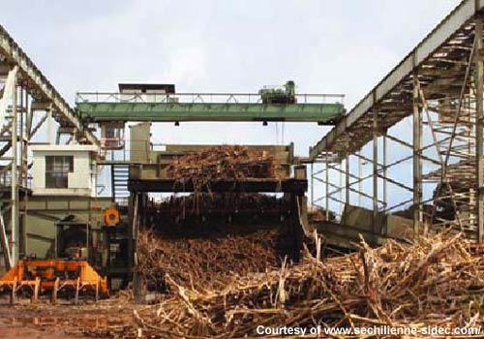
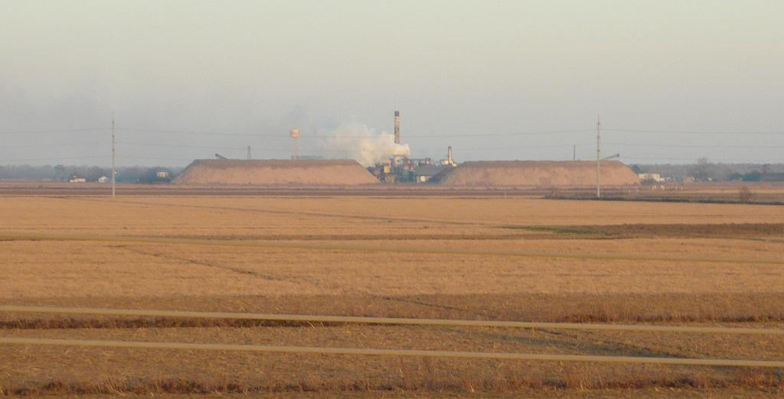
A problem and a chance: the misrelation of product and „waste“

Slide 4
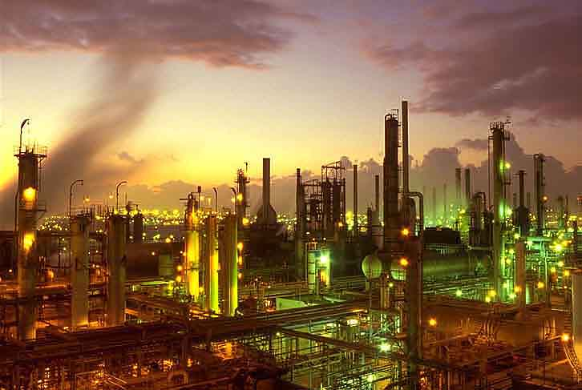
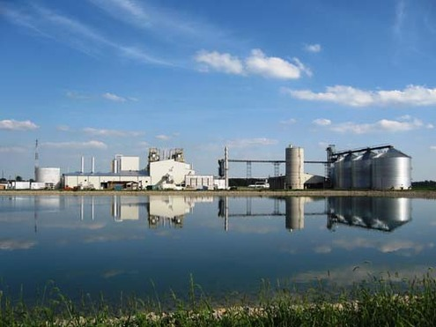
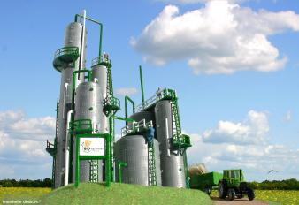
Towards a „covergent“ technology: the biorefinery approach
refinery
biorefinery

Slide 5
The use of complete biomass in biorefining
„top cut“ 0.1 % (e.g.patchoulol)
„medium cut“
30 % platform chemicals
e.g. lactic acid, green solvents
„base cut“
70 % „fertility, fuels and energy“
e.g. methane, coal, fertilizer and humic matter

Slide 6
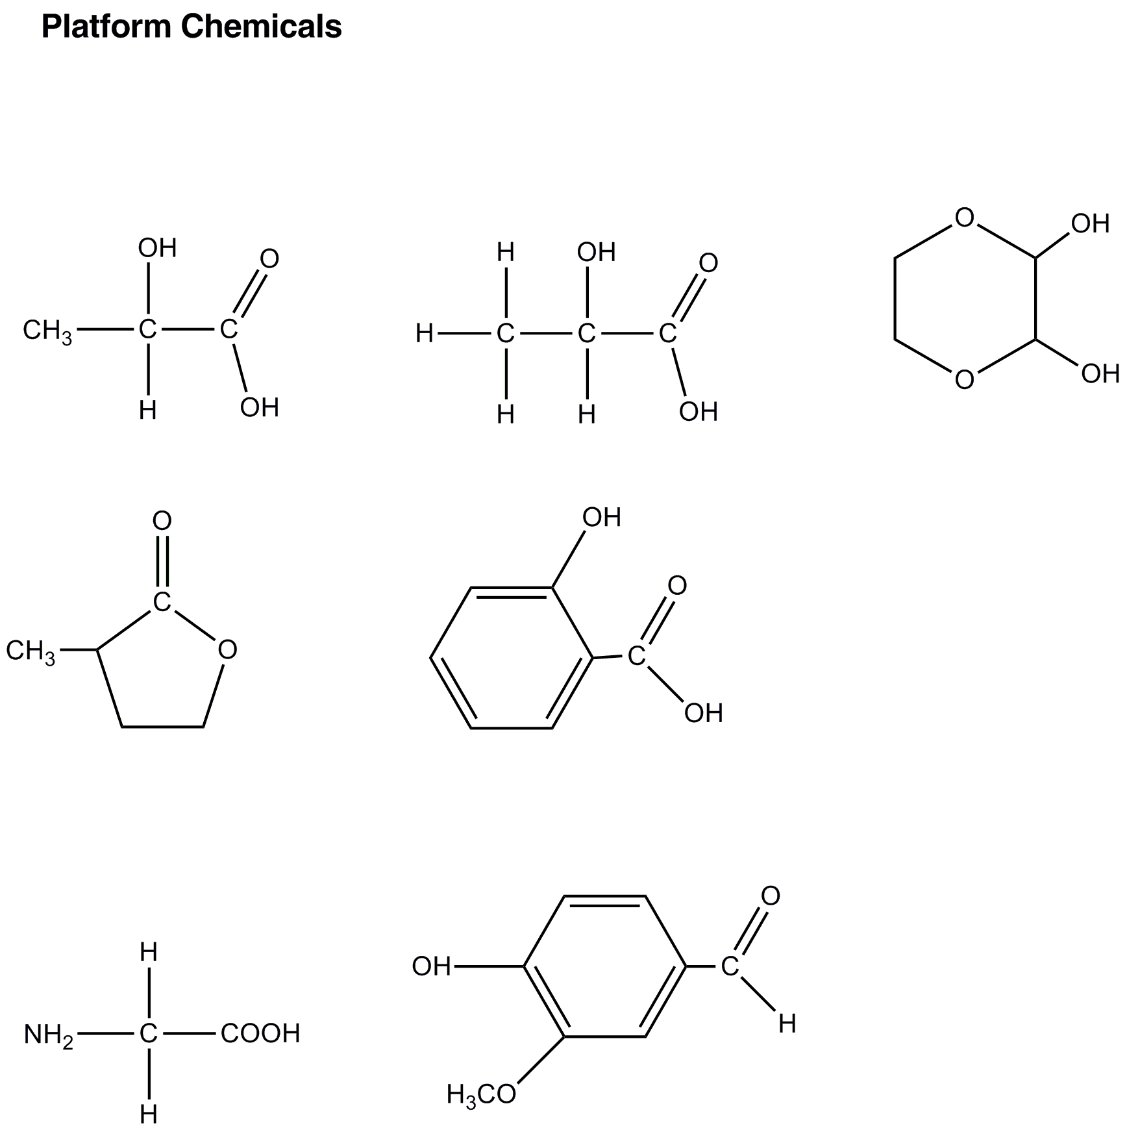
Aqueous HTR-processes
provide new platform chemicals
Lactid Acid
Gamma-butyrolacton
HTR = hydrothermal reforming/digestion

Slide 7
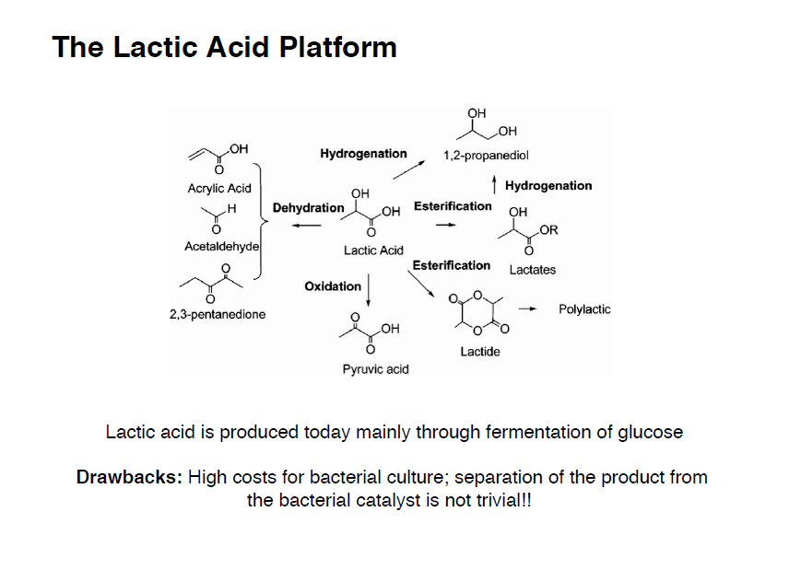

Slide 8
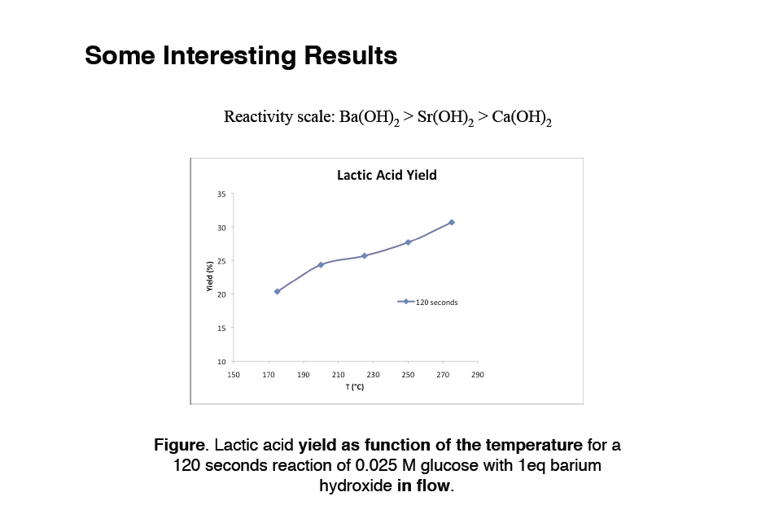

Slide 9
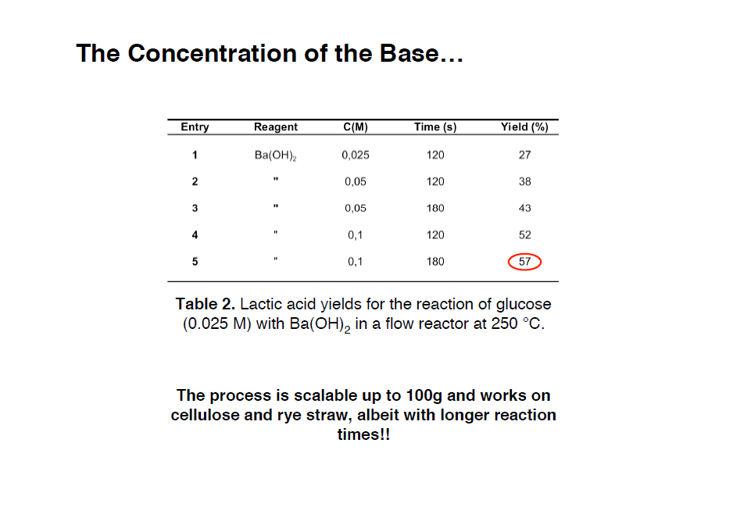

Slide 10
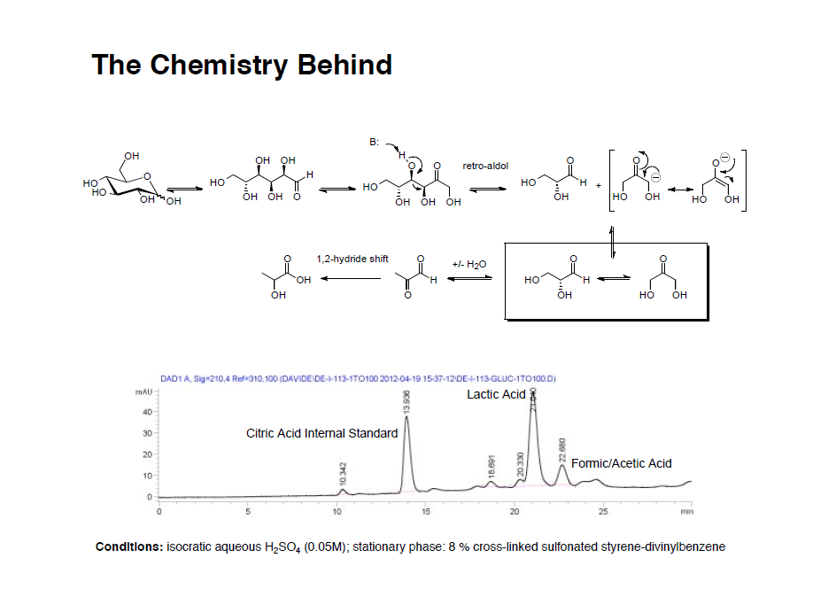

Slide 11
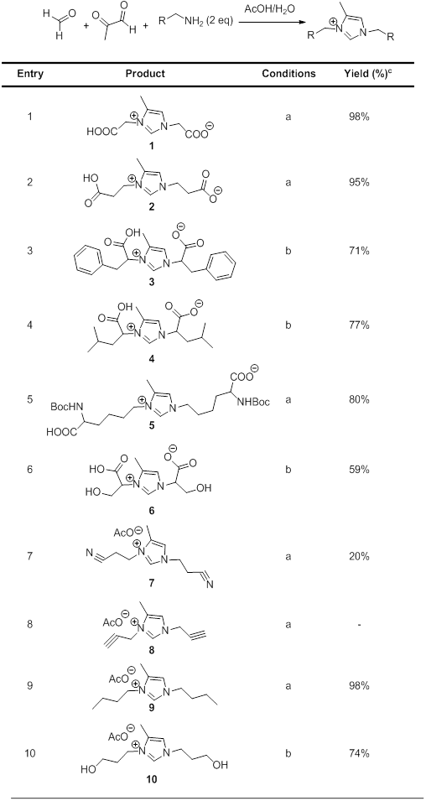
Same intermediate scheme: „Bio –ILs“
Debus-Radziszewski- reaction
1858
sugar + amino acid /amine
approach here:
„fundamentalistic“ green chemistry:
In water, near room temperature, no catalysts, equimolar reactands

Slide 12
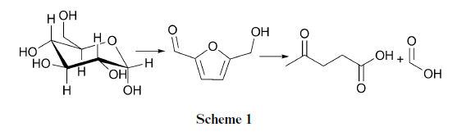
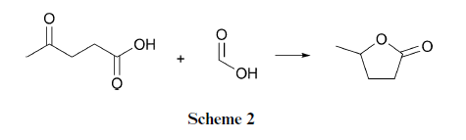
The Laevulic acid story
γ -methylbutyrolacton (γ-MBL) is a diesel replacement, LD50 higher than ethanol…

Slide 13
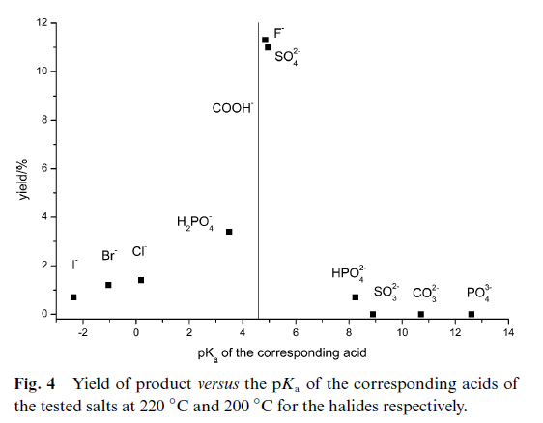
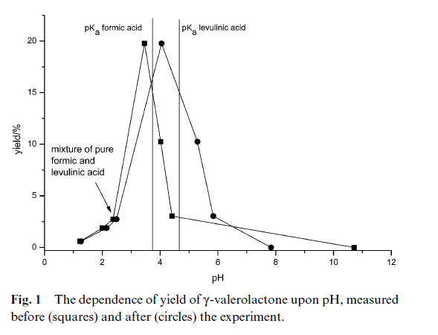
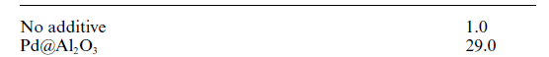
Hydrothermal Reforming/Conditions
20 min
data
fundamentalistic green

Slide 14
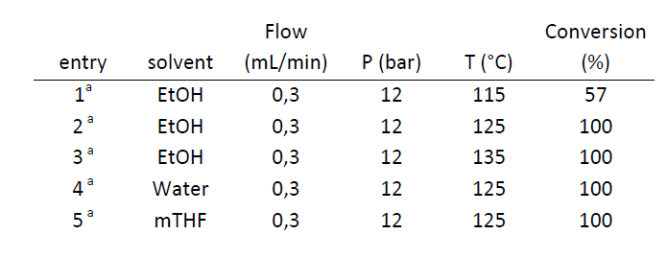
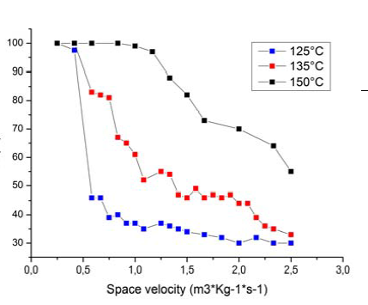
Real chemistry: H₂ and Ni/Bio-Ni-Catalyst
Current work with MPI Mülheim:
Cellulose → Glucose
H₂SO₄ → Laevulic Acid
LA → MBL
Estimated overall yield 60% (straw)
Side product: lignin, „humic acids..“

Slide 15
The use of complete biomass in biorefining
„top cut“-10 % (e.g.food + fibers)
„medium cut“
30 % platform chemicals
e.g. lactic acid, green solvents
„base cut“
70 % „fertility, fuels and energy“
e.g. methane, coal, fertilizer and humic matter

Slide 16
After HTR: Hydrothermal Carbonization
a technique to turn plant material
into monomers
into polymers
into carbonaceous materials
all in water
→ colloid and interface chemistry
Carbon efficiency ≈ 1
Friedrich Bergius described 1913 the elemental steps of HTC

Slide 17
Hydrothermal Carbonization
works via dehydration of carbohydrates
at 180 °C – 200 °C
for 2 – 16 h´s
C₆H₁₂O_{6 __}→ C₆H₆O₃ + 3 H₂O → C₆H₂O + 5 H₂O
quite cheap ( ca. 0.40 €/kg starch, 100 €/t biomass)
leads to useful nanostructures
with useful interface chemistry
„the dispersion polymerization of carbon“

Slide 18
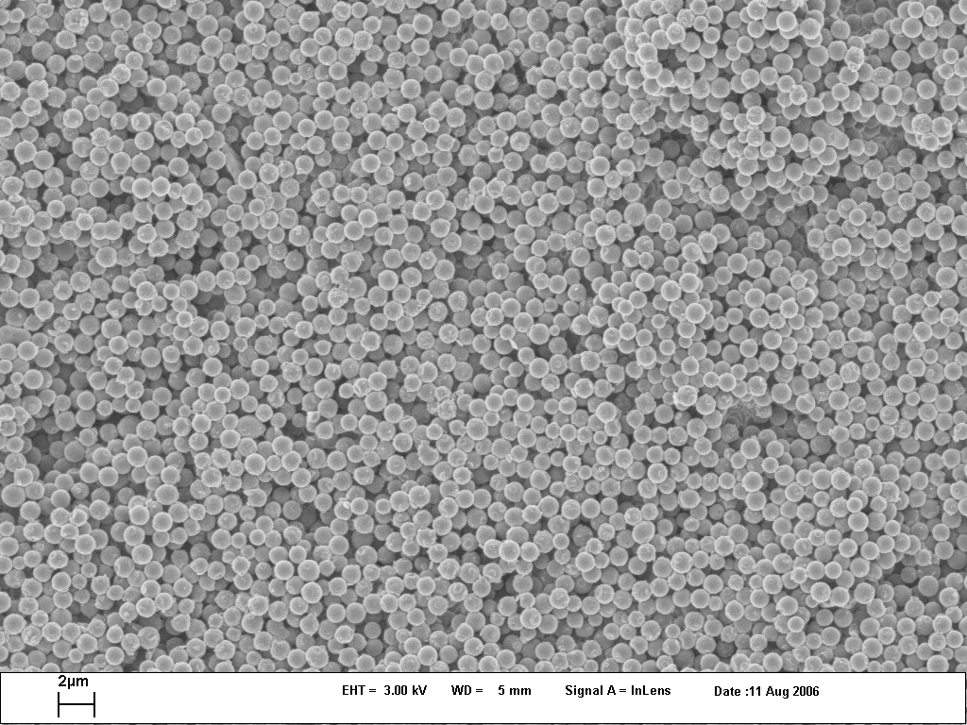
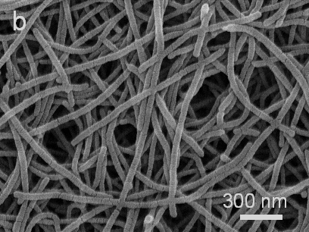
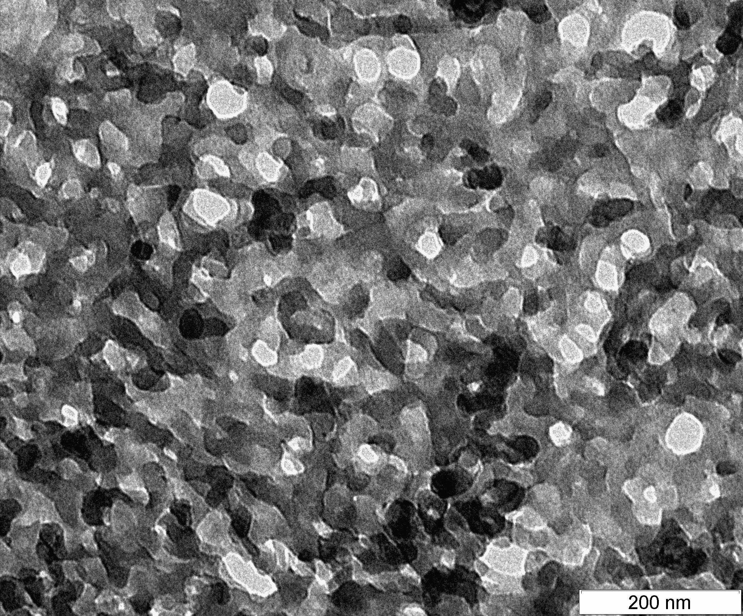
Carbonaceous structures to be made: (all from glucose/starch/biomass)

Slide 19
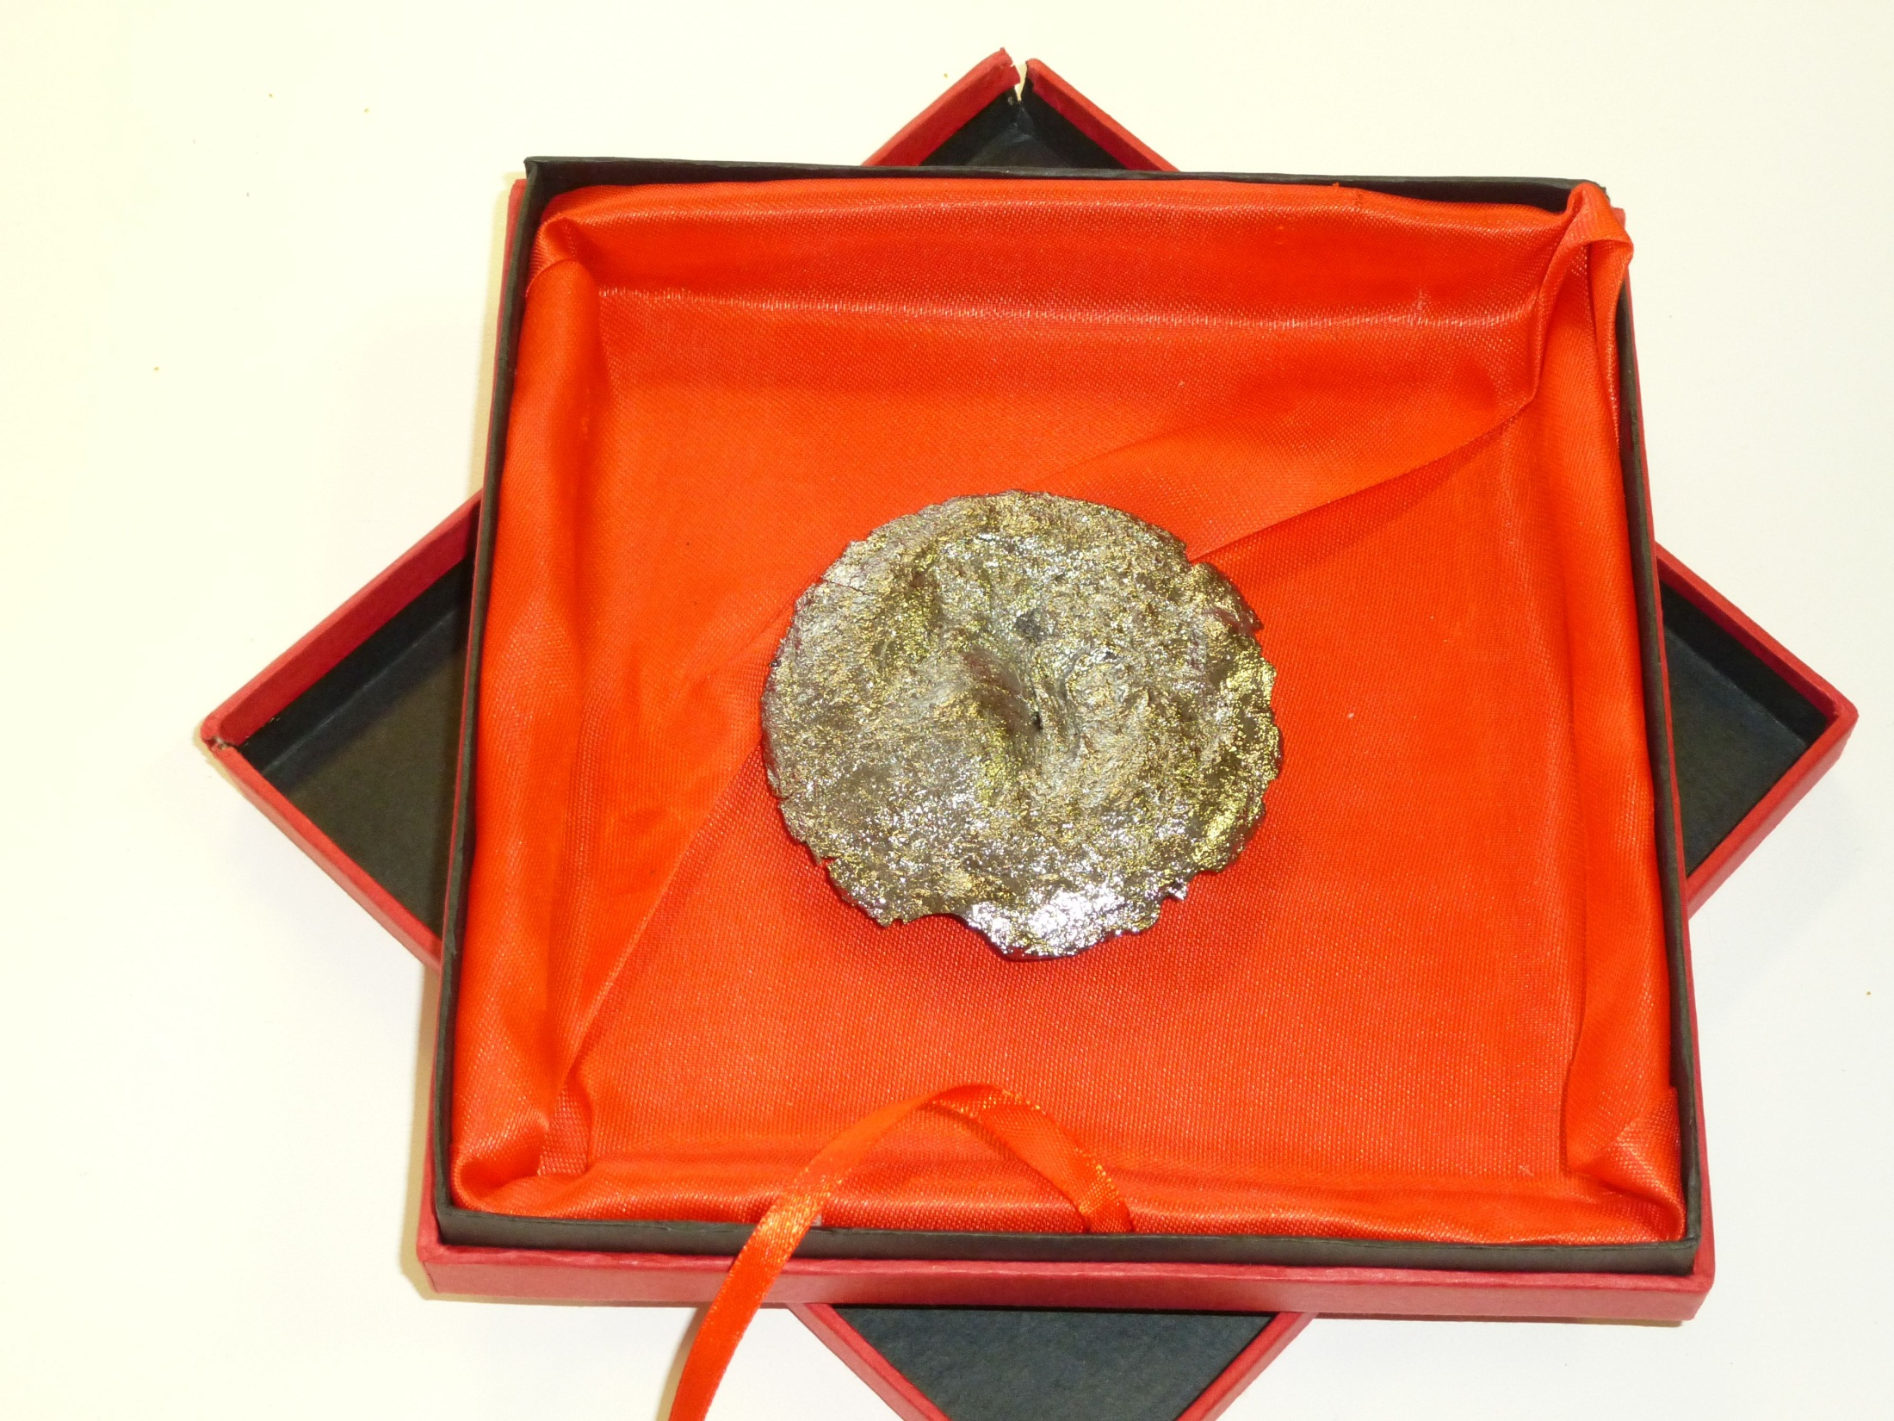
„designer-carbons“
Carbons new
to
mankind
noble carbon (N-C)

Slide 20
Case for Discussion:
Designer-Carbons for Energy Storage
the „race“:
Batteries versus Supercapacitors
I believe: Supercapacitors !
(but why ?)

Slide 21
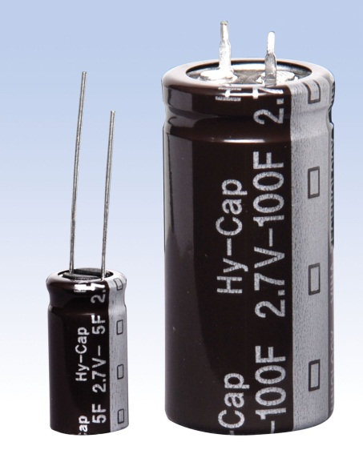
Supercapacitors made of N-containing Biomass
10 kg Material: 160 KW for 12.5 Sec.
Potential to beat all current storage technologies (availability, price)
Notes:
21

Slide 22
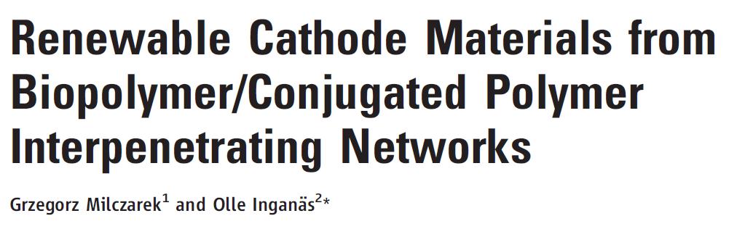
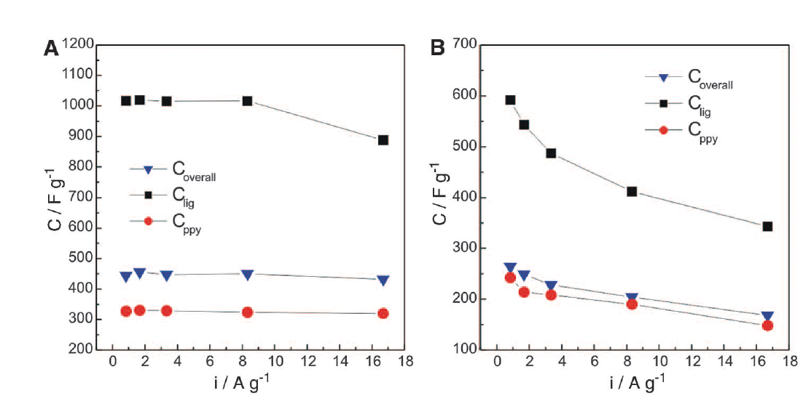
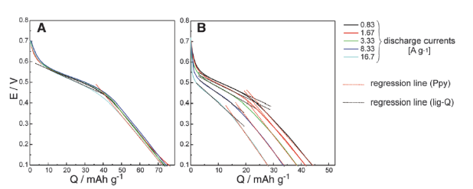

Slide 23
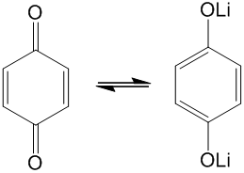
Energy Storage: Some lecturing
Supercapacitor: 300 F/g @ 1 V  1 e⁻ for 320 mass units
Capacitance of graphene/nanotubes: metallic theory
100 F/g,  1 e for 80 C-atoms
(Phys. Rev. E 83, 056102 (2011)
Pseudocapacitance
≈ 1.600 F/g
( polyaniline 1.100 F/g
Ni-foam 2018 F/g )
Energy density = 150 VAs/g = 42 mAh/g @ 1 V ( beats Pb-technology!)
Potential: E= ½ CU² - higher U: ionic liquids!
- higher C: carbon chemistry

Slide 24
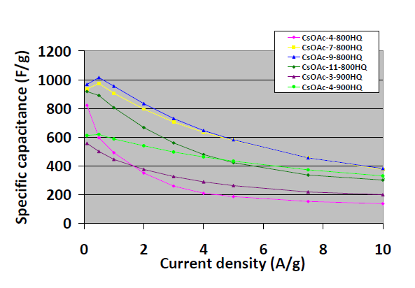
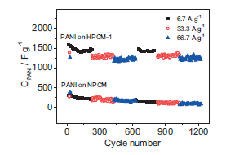
Own work on superporous carbons for Redox- Supercapacitors
with PANI (2007)
Salt templating with Q/HQ (2013)
visible: 1kWh/kg, price 5-10 €/kg ??

Slide 25
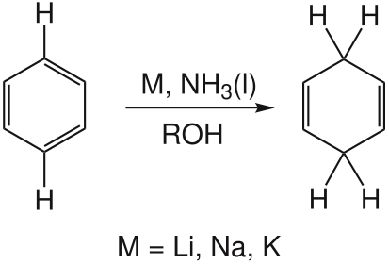
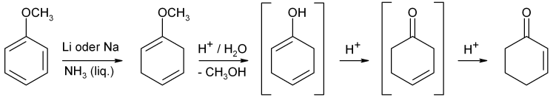
The Birch reduction as a charge
storage mechanism
(again:)

Slide 26
The Leitbild: decentral private energy storage as a key tool of the intelligent grid
Every private home has a –say- 1t electricity storage in the cellar (every windmill 10 t)
You buy electricity only when it is cheap and available (buffer)
Current fiction based on (top) science predicts 4 GJ/ton
ca 1 kWh/kg = 1000 kWh buffer capacity
economy: saves 1000 Euro/year per family
Secondaries: savety, price (maybe 5 -10 Euro/kg)

Slide 27
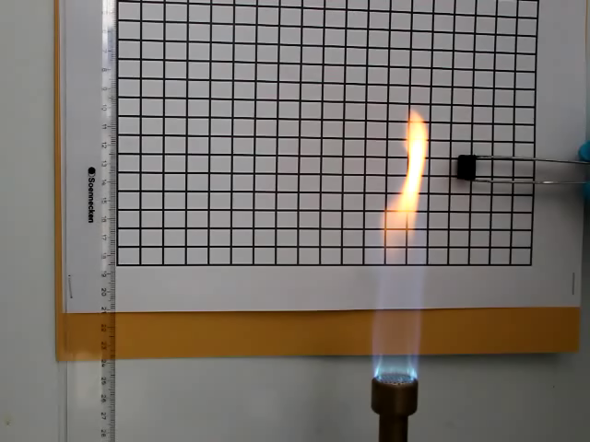
Noble carbon → flame retardance

Slide 28
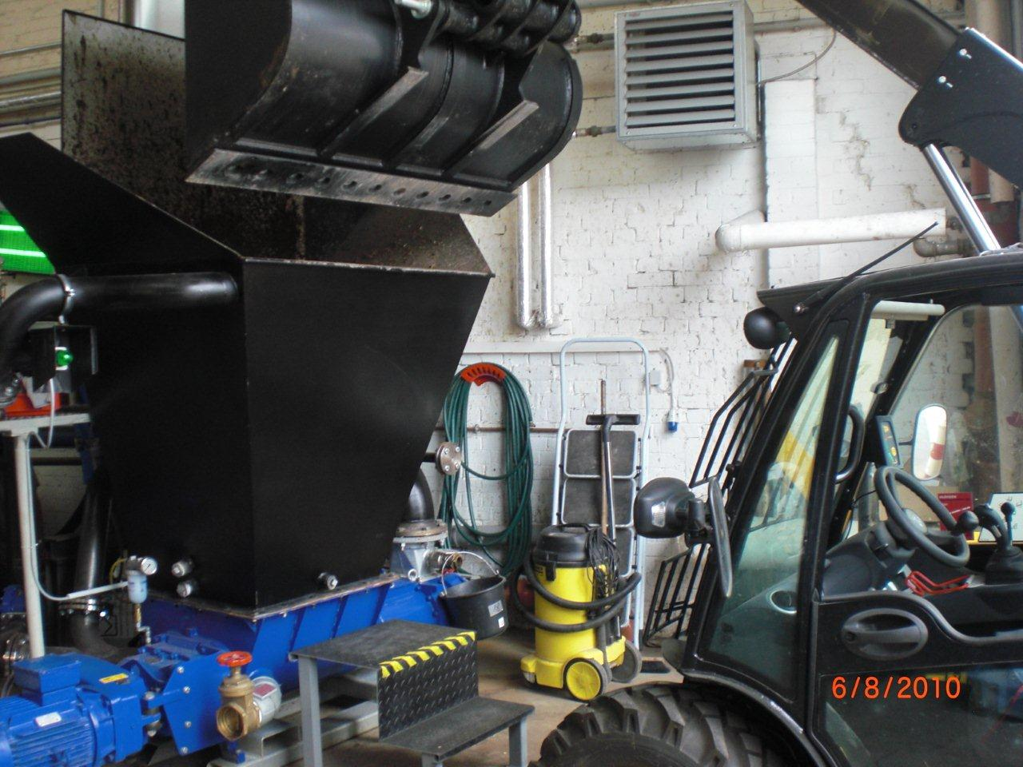
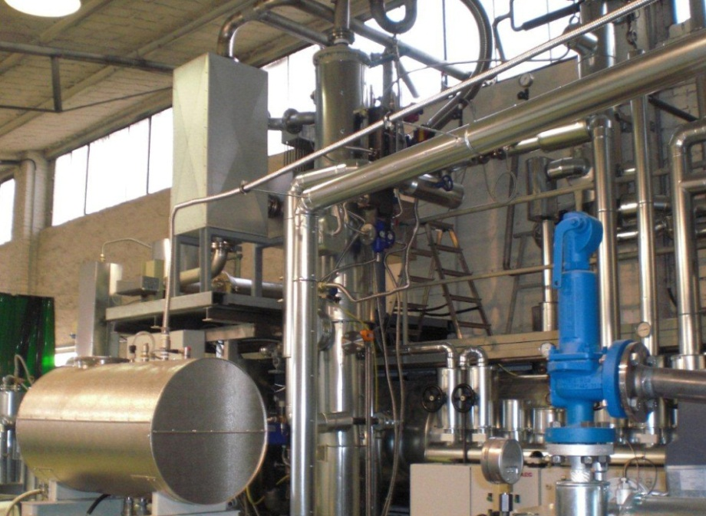
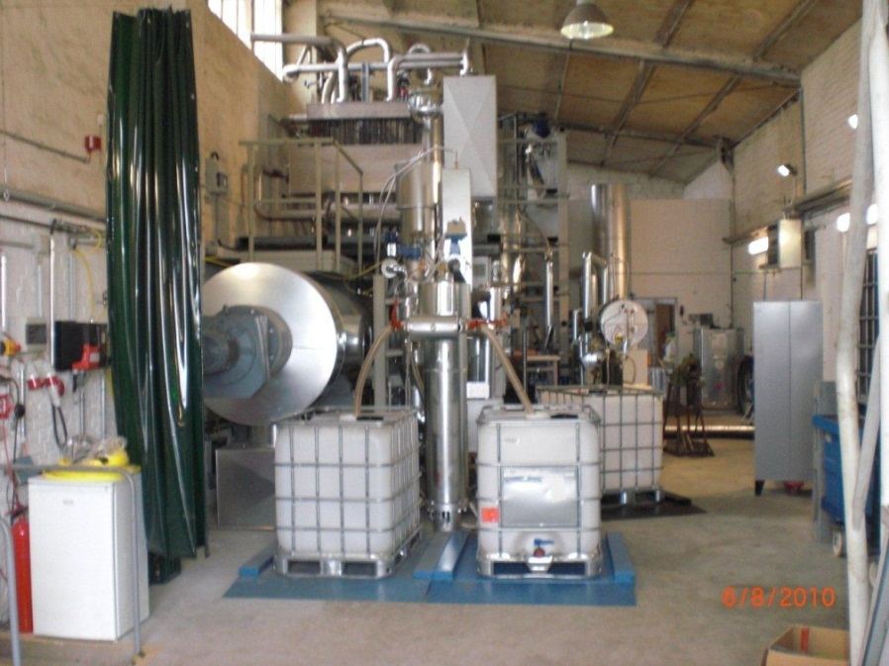
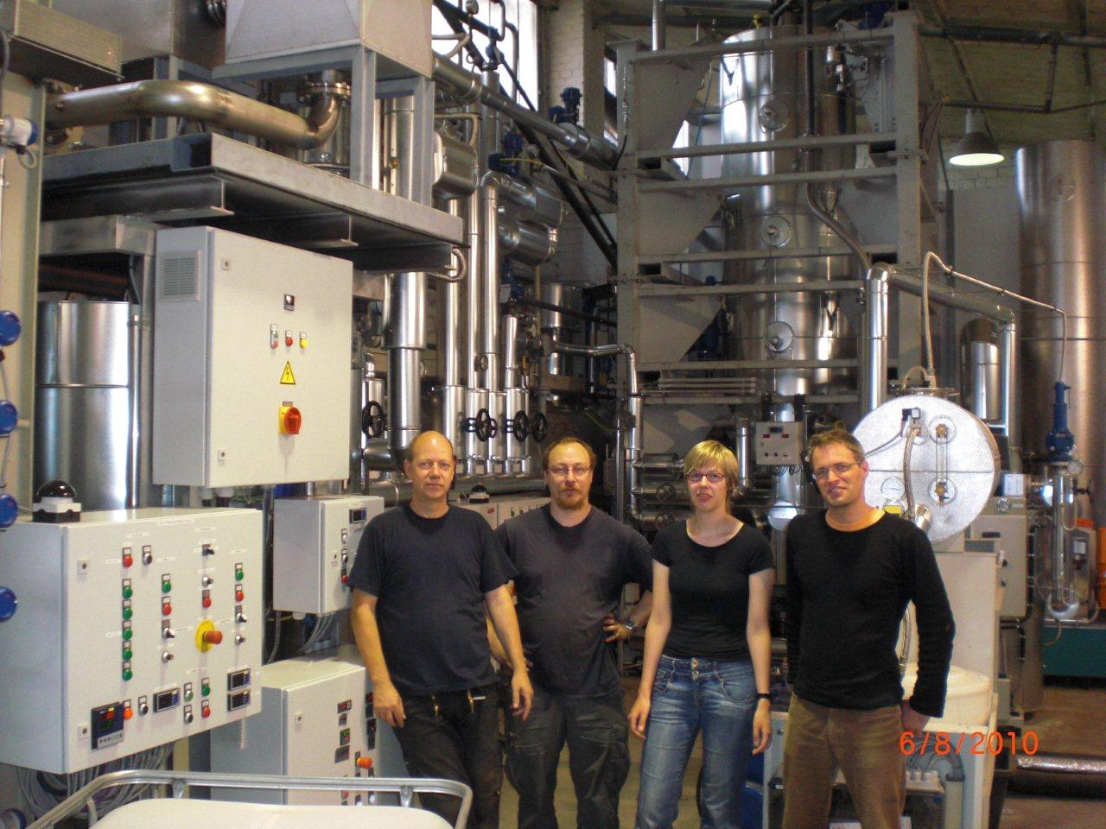
A pilot plant, VC & MaxPlanckSociety

Slide 29
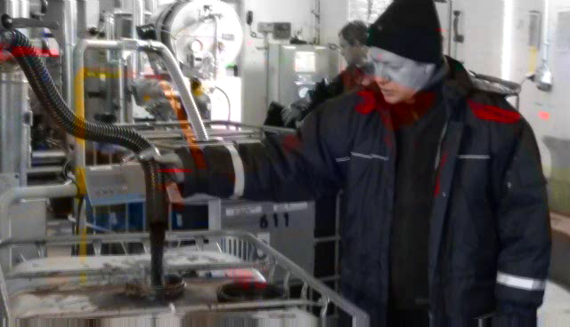

Slide 30
PIL for N-doped carbon membranes
N-doped carbon (highly conductive, catalytically active, etc.)
Precursor: imidazolium- and pyridinium-ionic liuqids.
Electrospinning: powerful tool to prepare fibers and mats / membranes.
Project: prepare N-doped carbon membranes by electrospinning
Polym. Chem. 2011, 2, 1654

Slide 31
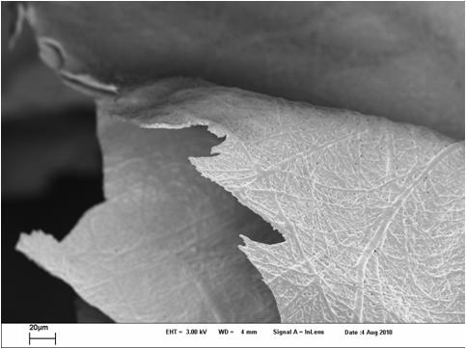
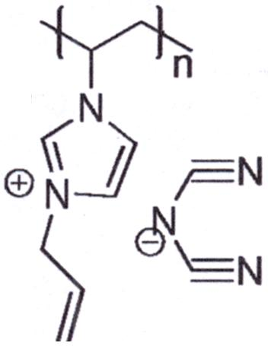
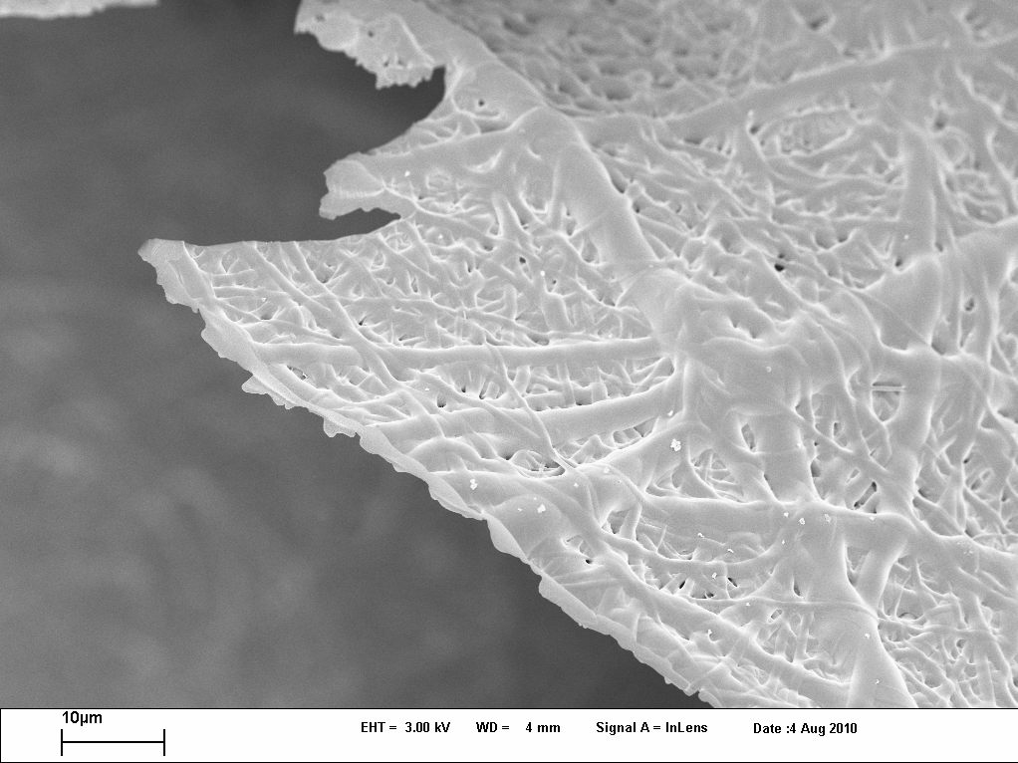
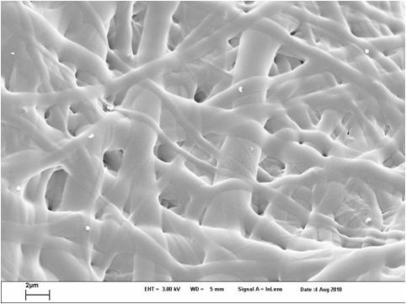
Carbon mats / membranes
At 1000°C
N content : 6.33%

Slide 32
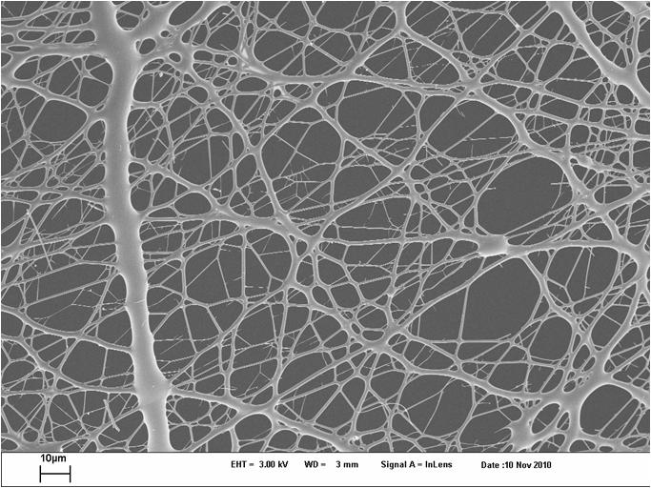
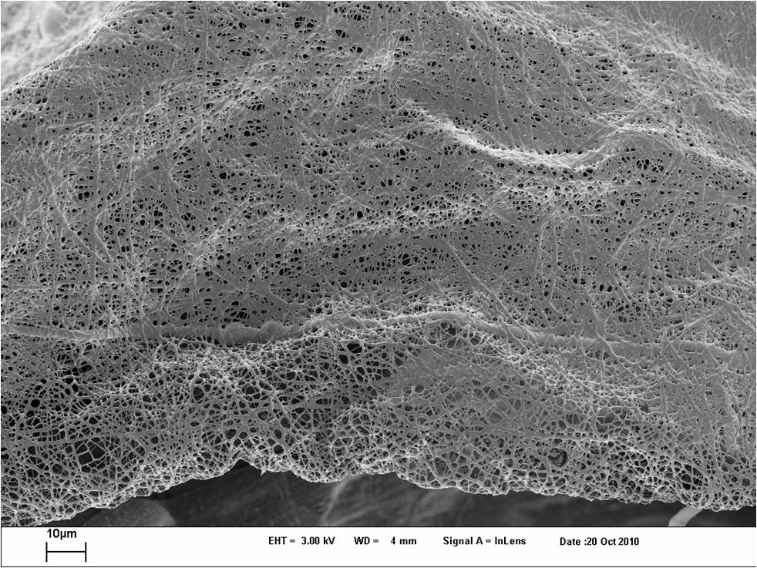
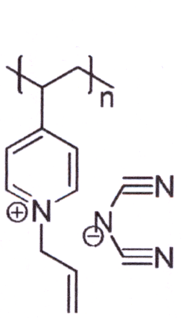
Carbon membranes
N content : 8.00%
Conductivity: 200 S/cm

Slide 33
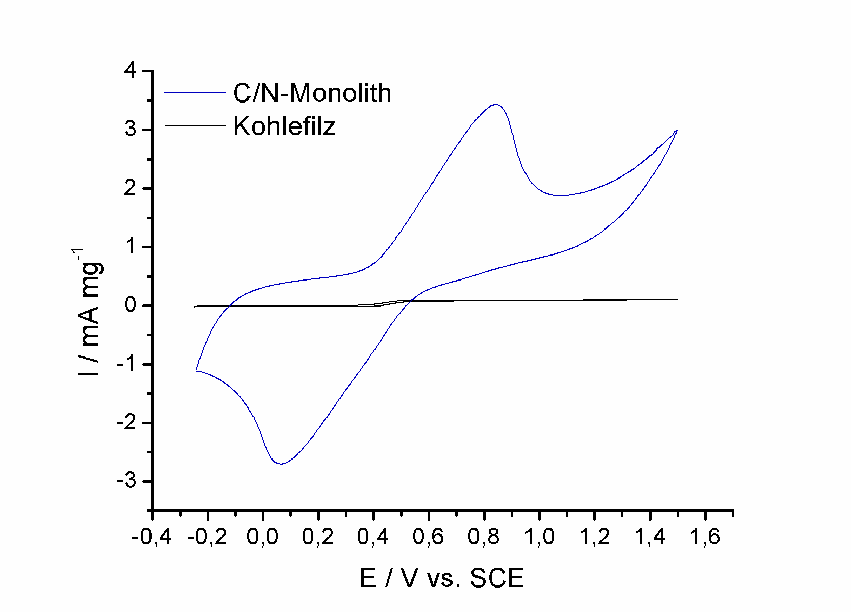
Dynamic Performance as an electrode
C/N-Monolith
Comm. fuel cell carbon fleece
Notes:
33

Slide 34
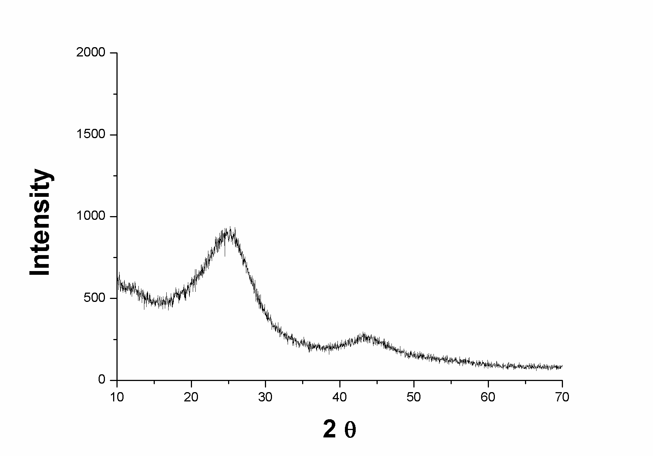
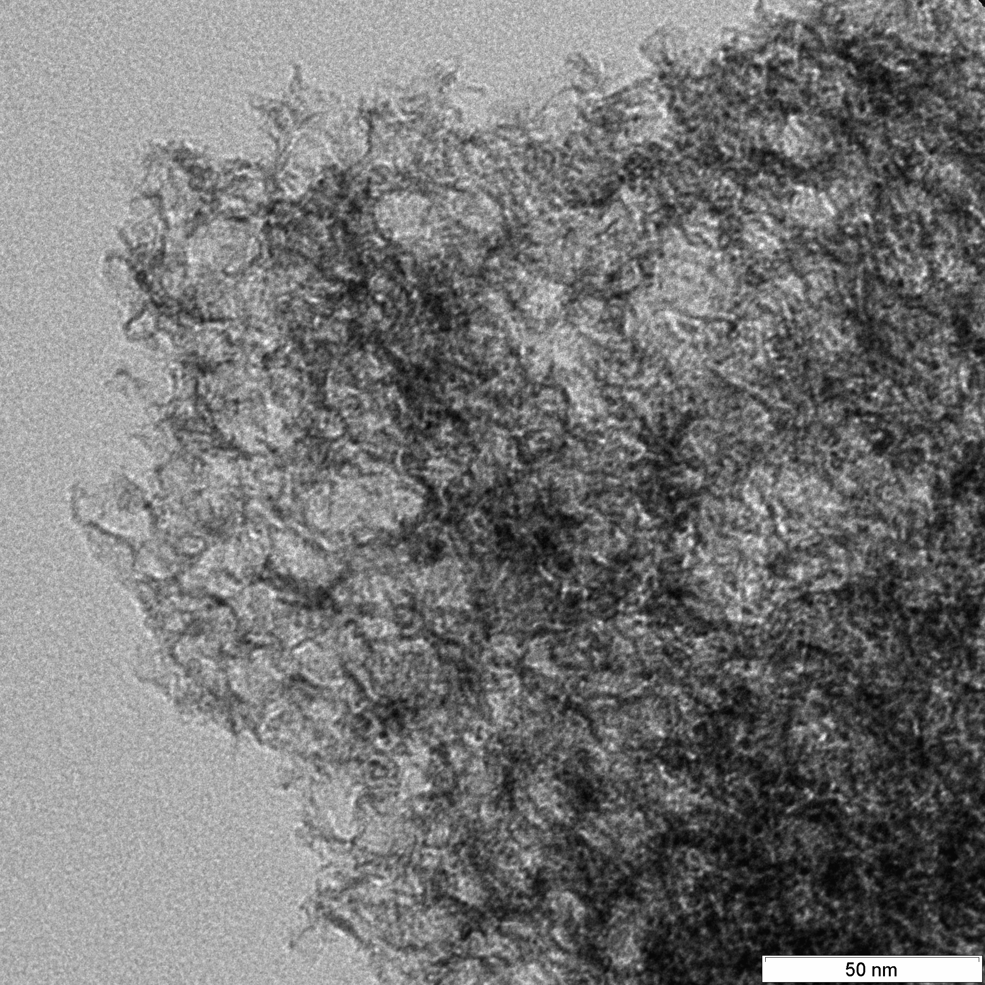
ORR: “Metal Free” O₂-Activation by Porous N-doped carbon materials
Highly conductive, highly noble, basic:
an electrocatalyst !
Hybridisation with nucleobases
dissolve in ILs
Increase of N-content to 15 wt%
all data: Dr. Wen Yang, Tim Fellinger, Nina Fechler
JACS 2011
Notes:
34
34

Slide 35
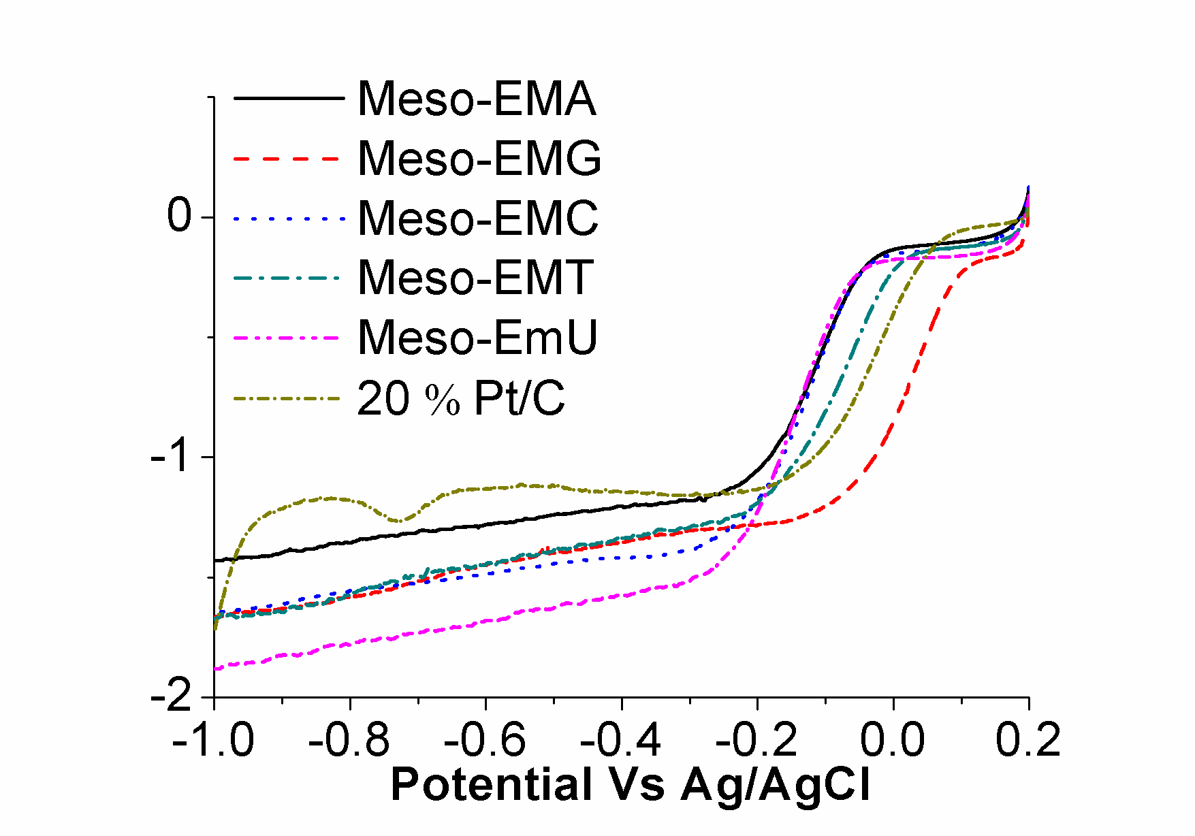
Electrochemistry- ORR
Rotating-disk voltammograms recorded for Meso-Em/nuclebase and 20 wt % Pt-C in O2-saturated 0.1 M KOH.
Notes:
35
35

Slide 36
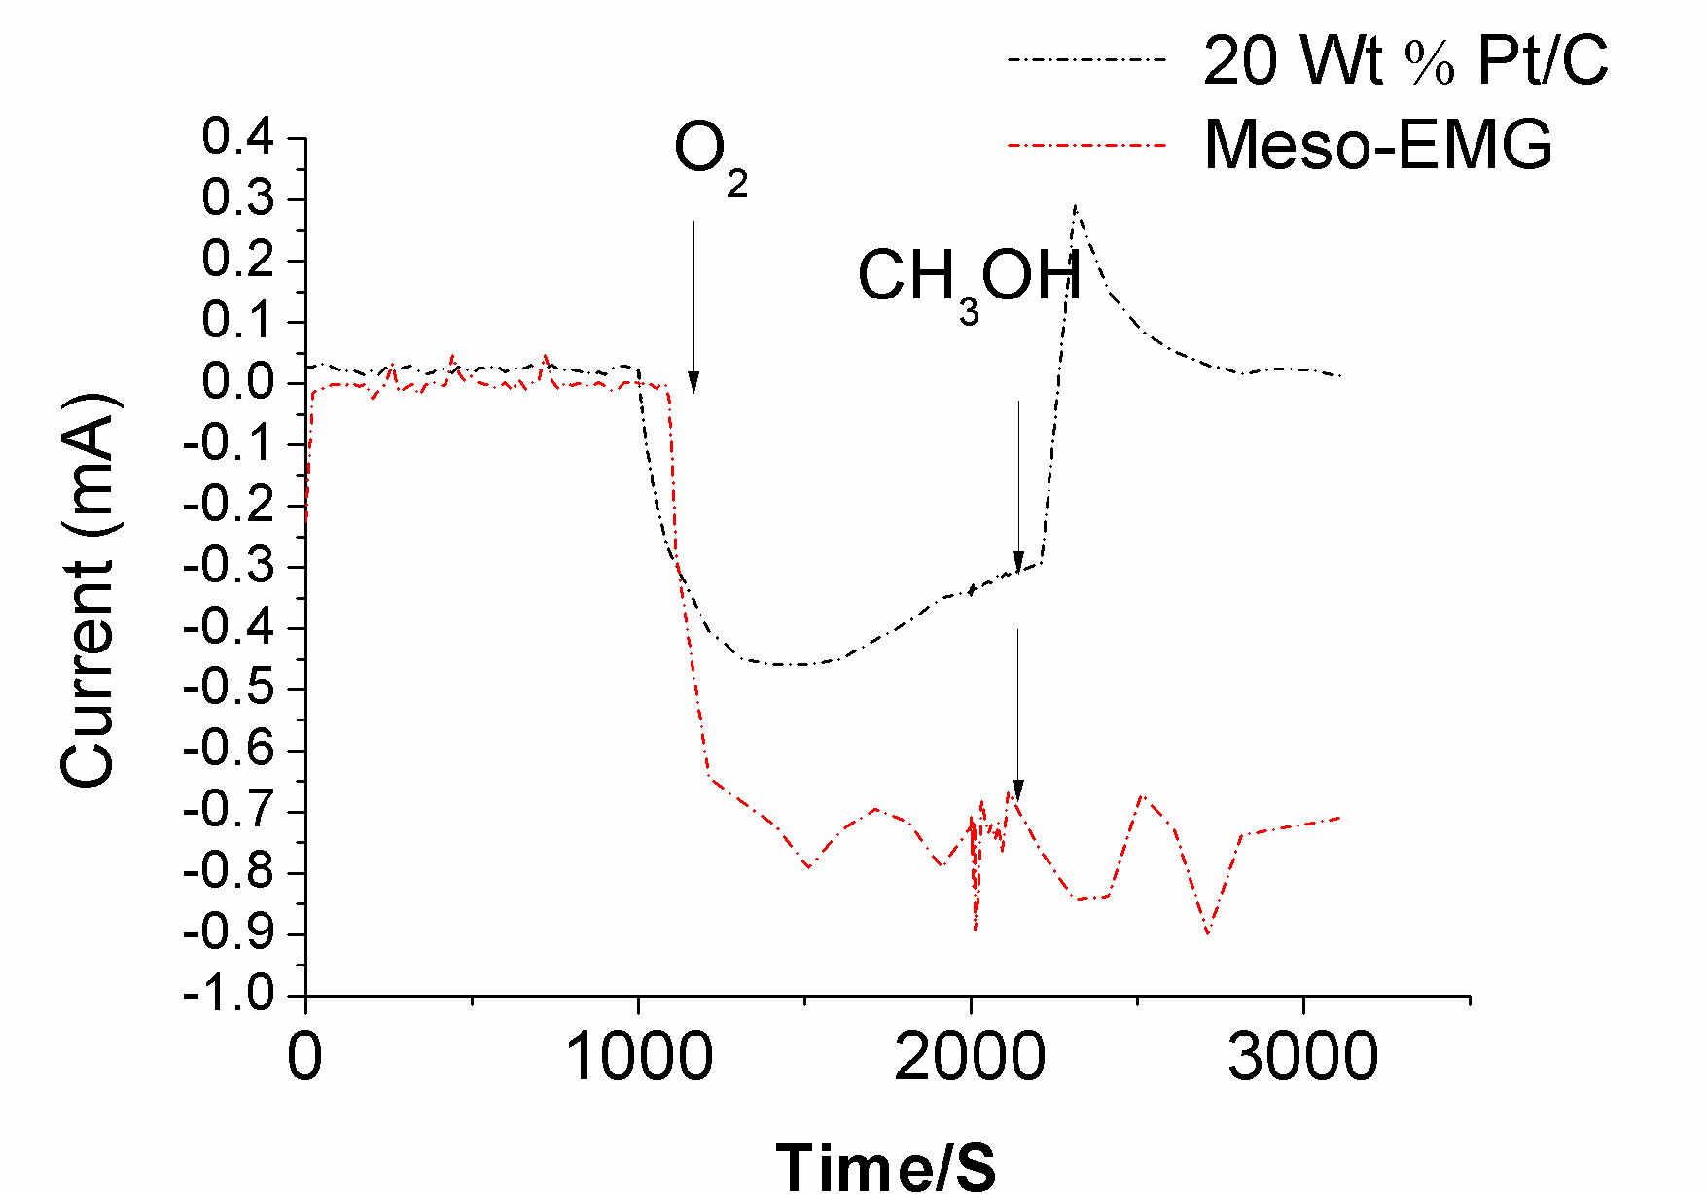
Electrochemistry-Stability
Notes:
36
36

Slide 37
The newest generation:spin bopper
0.05M H₂SO₄,
O₂, 1600rpm
alkaline
acidic !
stability test

Slide 38
C/N on Nickel foam: Oxygen liberation
0,1M KOH
Pt as counter electrode
Ag/AgCl as reference electrode

Slide 39
The other side: C/N@FTO: H₂-liberation

Slide 40
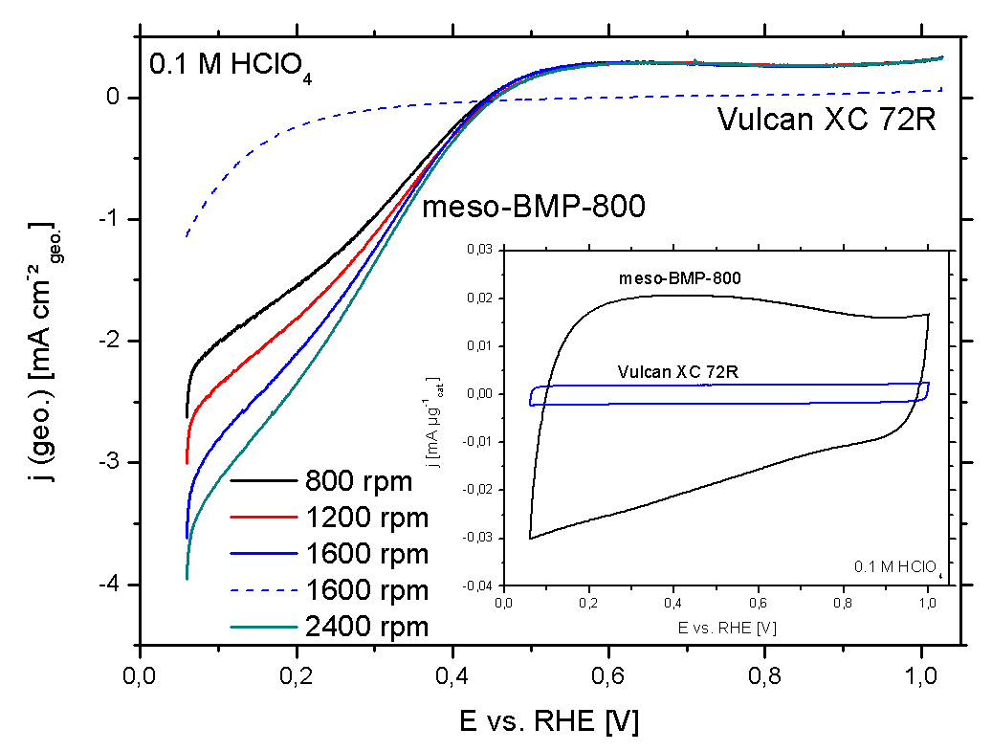


Electrochemical Synthesis of H₂O₂
Price: 2.4 cents kg⁻¹ H₂O₂
at 10 cents per kWh⁻¹ !
With Tim Fellinger, Peter Strasser, Frédéric Hasché

Slide 41
A big jump: 5 slides on carbon nitride
graphitic C₃N₄
an organic semiconductor, from sustainable usea
Liebig, 1834
Jürgens et al., JACS 2003
Liu et al., Science 1989

Slide 42

Band positions: ideal for the photocatalytic water splitting

Slide 43
H₂ evolution on Pt (0.5 wt%)-loaded C₃N₄
λ > 420 nm
H₂
N₂
Catalyst, 0.1 g, Reactant solution, aqueous triethanolamine solution 100 mL 10 vol.%; Reaction vessel, Pyrex top irradiation-type; Light source, xenon lamp (300 W) attached with a cutoff filter

Slide 44



Photochemical Cofactor regeneration (a Frankensteinian experiment)
the NAD⁺/NADH couple
Enzyme
Sub
H-Sub

Slide 45




NADH-generation under optimized conditions: Coining Light energy into biological currency

Slide 46
Conclusion
biorefining: HTR and HTC
Lactid acid, IL-monomers, Γ-MBL
supercapacitor carbons: performance@batteries
noble carbons: spinneable electrodes
new designer carbons
ORR catalysts, O₂ and H₂O₂ generation, metal-free
optical NADH-regeneration, now electrochemical ??
closing the missing pieces in biorefinery schemes

Slide 47
Chemistry with a
golden-green
future

Slide 48

Thanks to those who really did the work:
the Carbon-
people
Notes:
48

Slide 49


Department of Colloid Chemistry
MPI of Colloids and Interfaces
Thanks to the Max Planck Society:
Research for long term problems
ENERCHEM 2005 ERC2008

