Slide 1
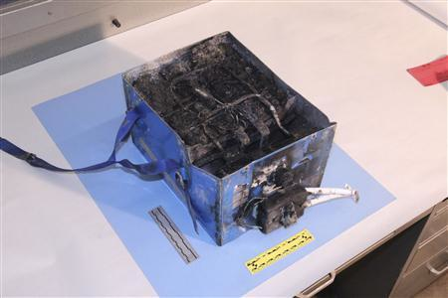



EASAC Stockholm Sep 19 – 20 2013
“Electrochemical energy storage, activity on all fronts”
Michel Armand
Charred Boeing 787 Dreamliner Battery
CNRS – Université de Picardie Jules Verne – France
CIC Energigune, Vitoria – Spain
Deakin University, Melboure – Australia
Notes:
PORTADA

Slide 2
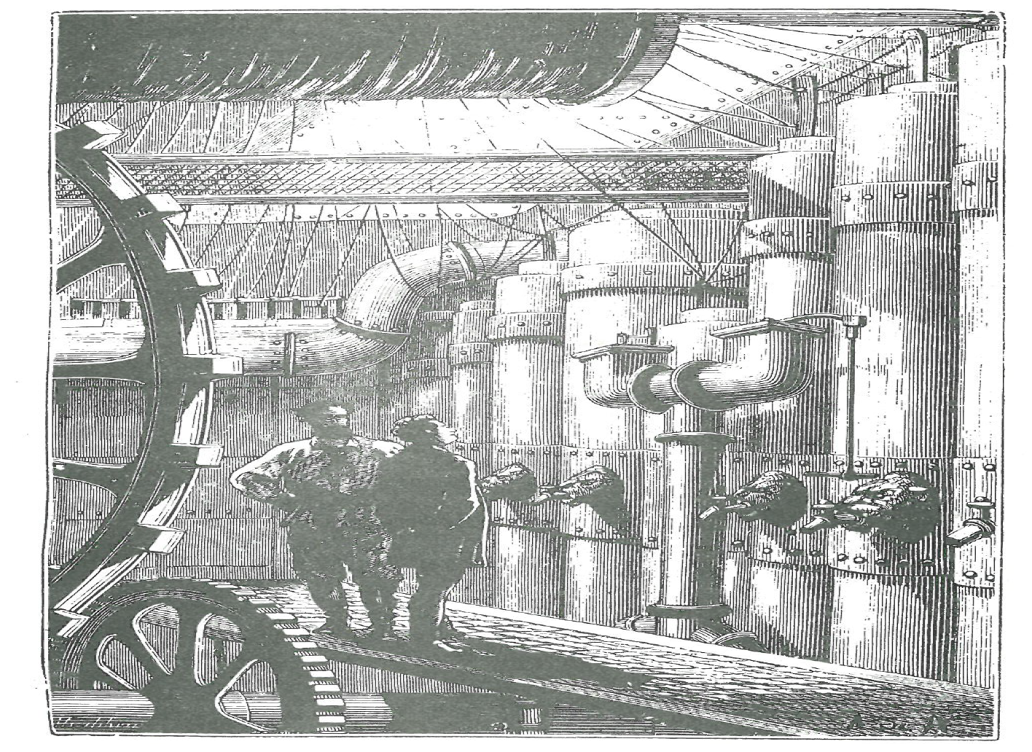
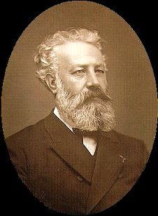
Our forefathers…
- Sodium?
- Yes Sir. Mixed with mercury, it forms an amalgam which replaces zinc in Bunsen cells. The mercury lasts forever. Only sodium is consumed and the ocean provides it.
- . Furthermore, sodium batteries are the most energetic, and their electromotive force is double that of zinc cells.
Jules Verne
Twenty Thousand Leagues Under The Sea Hetzel Publisher, Paris 1870

Slide 3

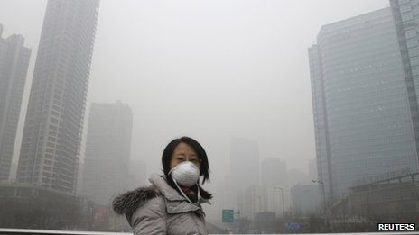
1 Billion Cars in 2010 and ➚
…and 1.3 10⁶ fatalities on the roads!
> 2 10⁶ premature deaths from air-borne particles in big cities

Slide 4
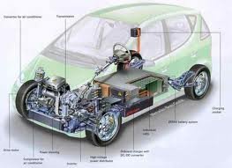
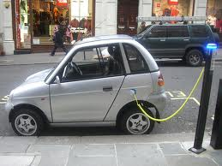
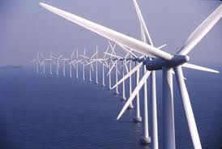
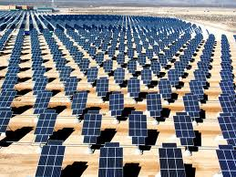
Needs for electrochemical storage…
Automobiles
Load-levelling
1.10⁹ cars 10% electric
World electricity production
= 2.10¹³ kWh 10% stored/day
➔ 20.10⁶ tons batteries
➔ 60.10⁶ tons batteries!
Sustainability a prime criterion!
Notes:
EJEMPLO PANTALLA

Slide 5
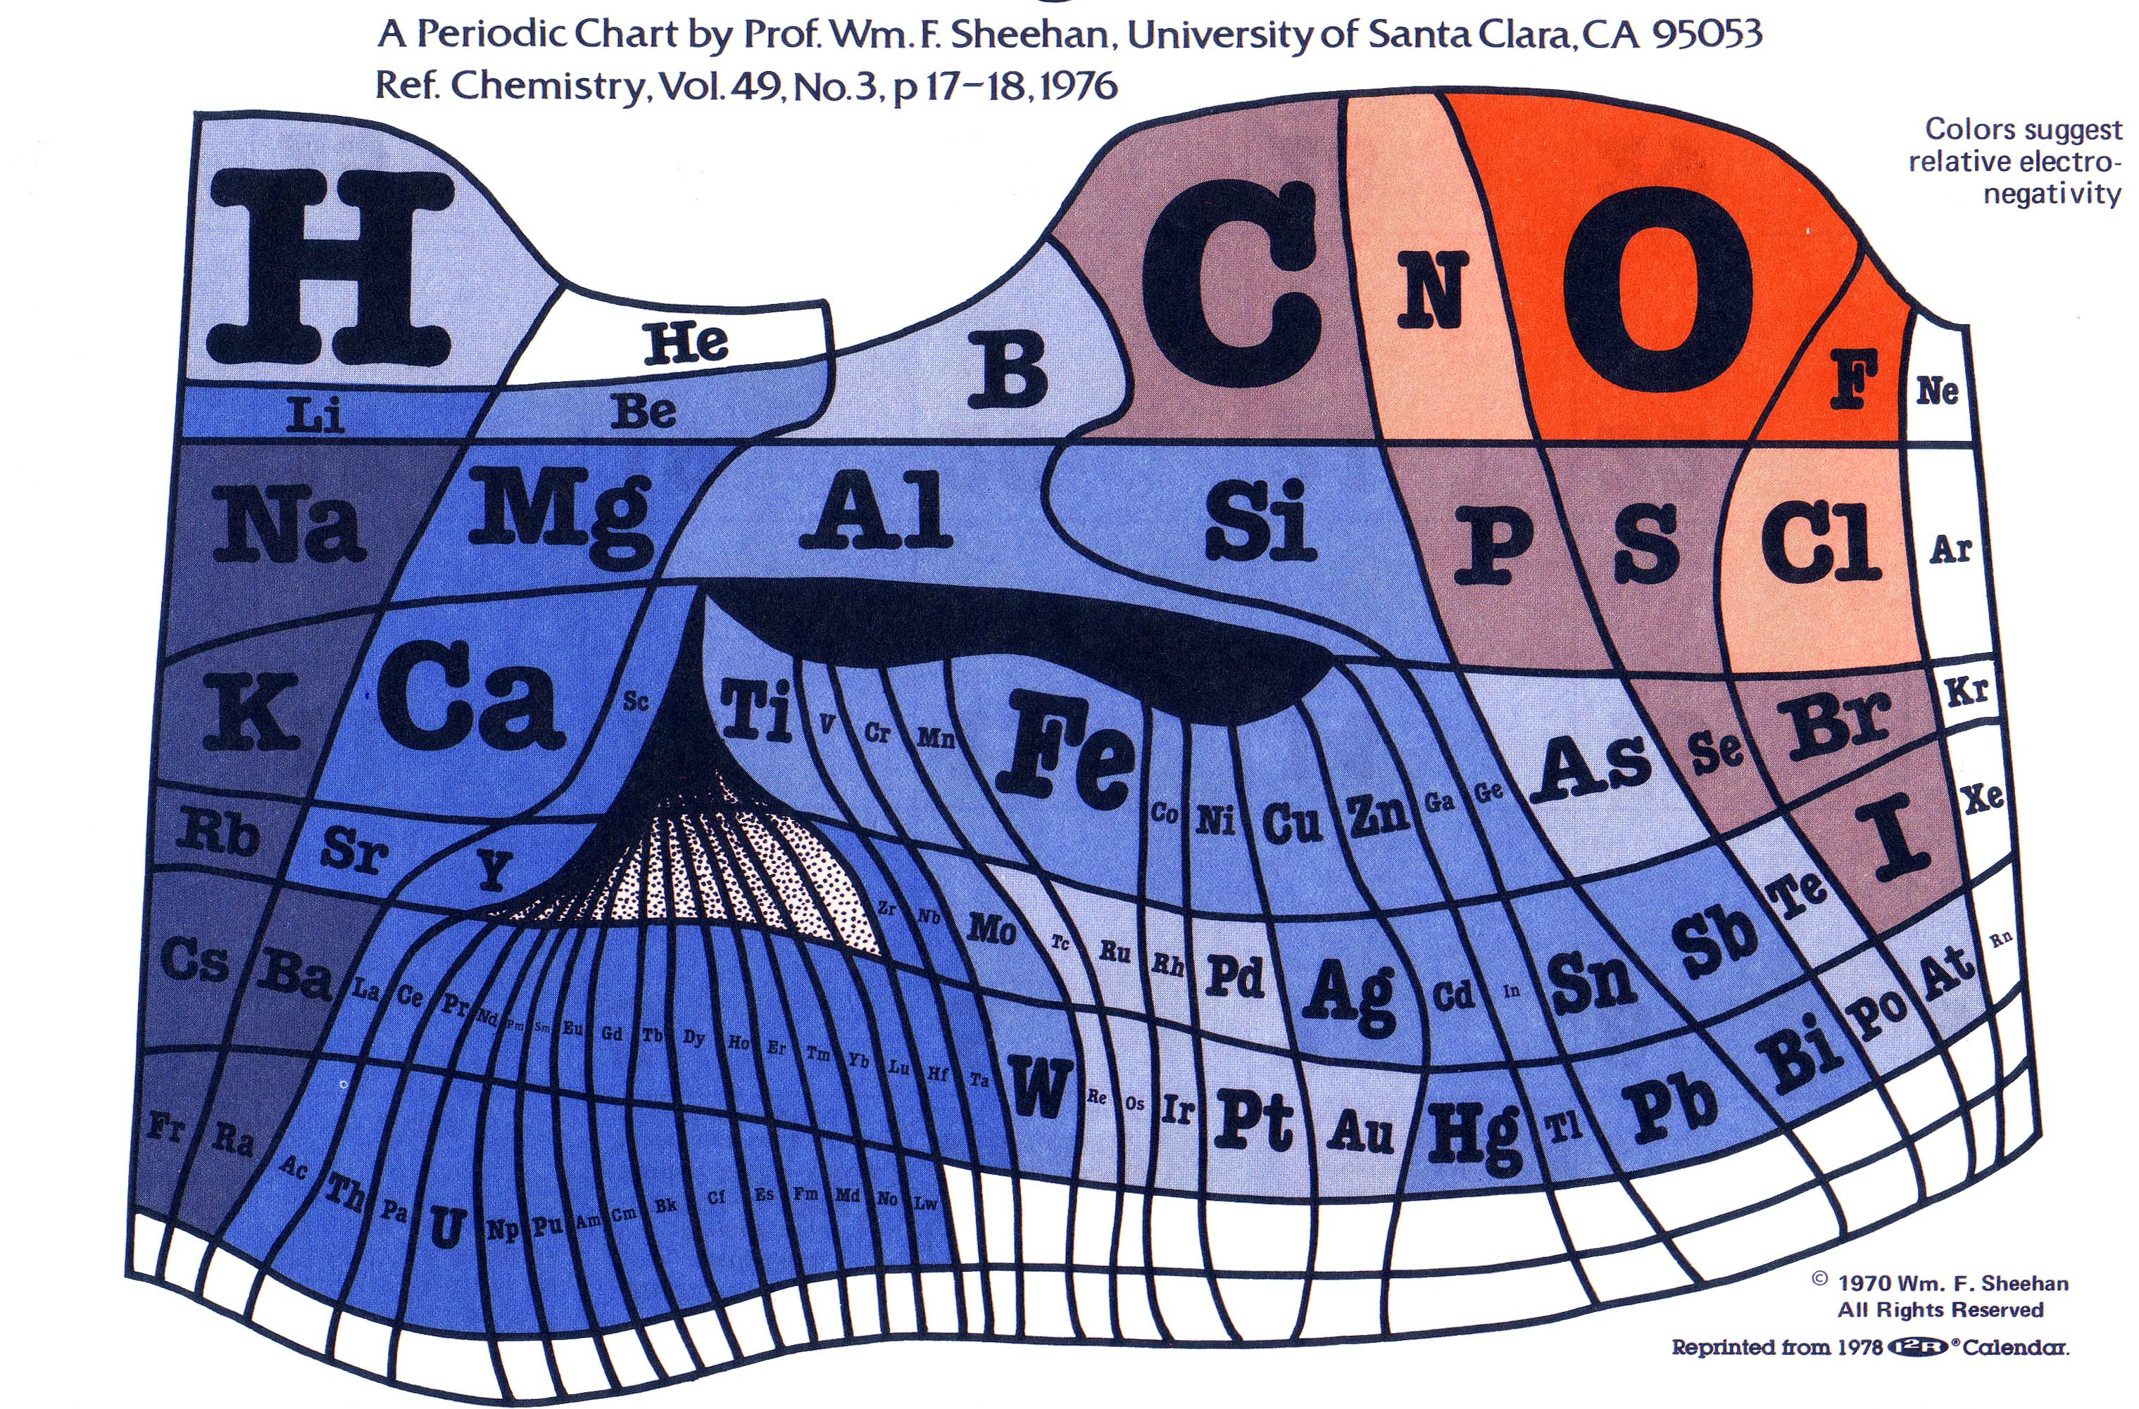
The periodic table according to abundance

Slide 6
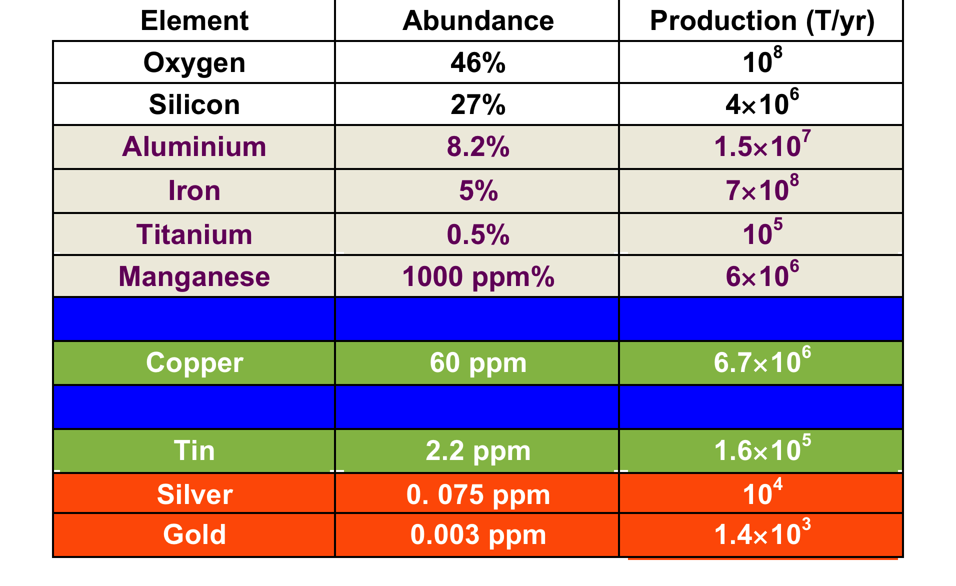
Elements and mankind
20 tons of CO₂ / ton of Al
2 ton of CO₂ / ton of Fe
50 tons of CO₂ / ton of Cu!
CO₂ signature of copper to increase further!

Slide 7
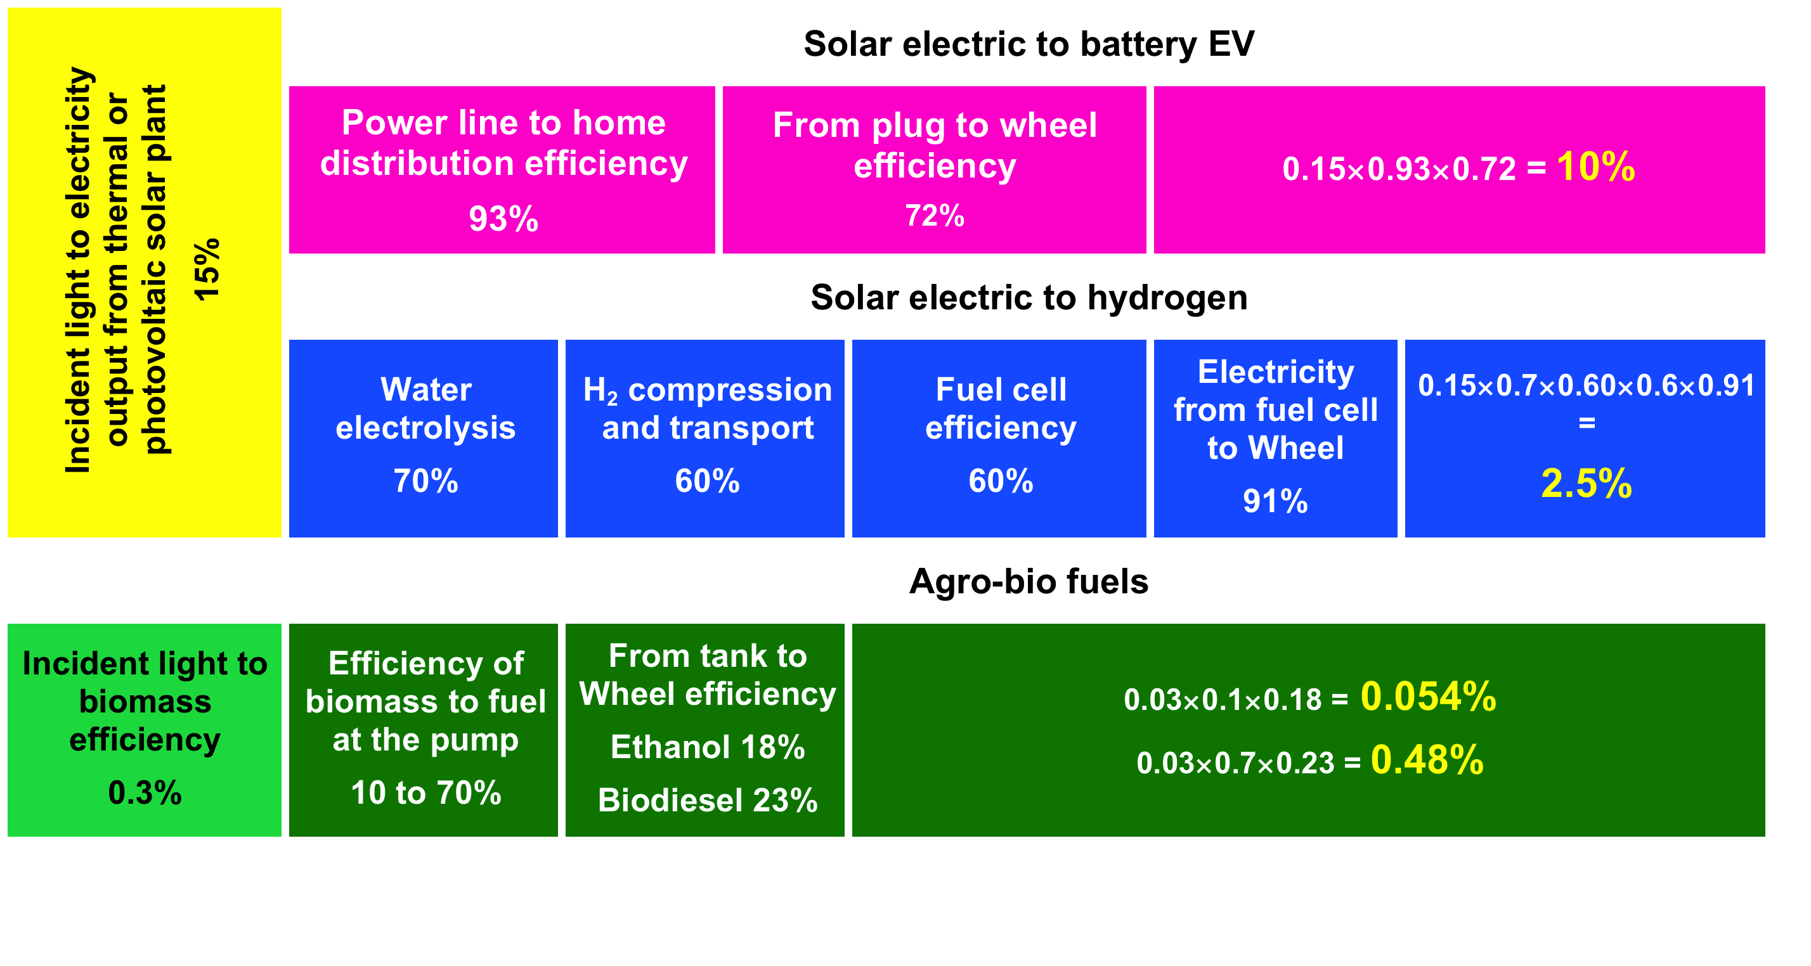
Energy and transportation…
• Charger/transformer 90%
• Battery C/D efficiency 90%
• Power electronics 98%
• Electric motor 91%
Without regenerative breaking

Slide 8
The“100” rules
 Batteries capacity @ 100 Wh /Kg = 1% of hydrocarbons energy content
 100 W/Kg = Charge/discharge in 1 hour “C” rate
 EV consumption @ 100 Wh/Km/ton
 Evs: 100 Km of driving range per 100Kg of battery weight

Slide 9
Li batteries of all sorts…
Polymer
Li° Solid-state batteries
T > 50°C
liquid
liquid
Li-ion batteries
-20 < T < 55°C
Copper
gel
Future gel, ionic liquid or all solid
higher capacity?

Slide 10
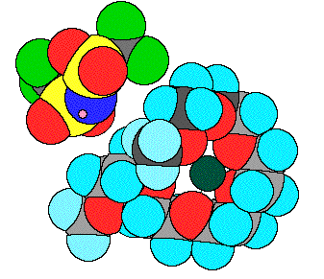
3 Families of electrolytes
Glasses: SiS₂/Li₂S/LiI
PEO / [(LiCF₃SO₂)₂N]
Liquids: LiPF₆ in EC
300 m² of electrolyte, electrode for an EV battery
T_{g} ≈ 270°C; t_{Li+} = 1
T_{g} ≈ -40°C; t_{Li+} = 0.3
T_{g} ≈ -100°C; t_{Li+} = 0.3
Temperature of operation

Slide 11
Aging / Failure modes
Li-ion
LMP

Slide 12
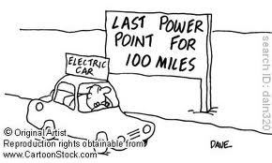
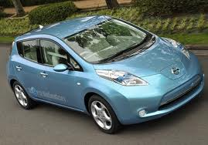

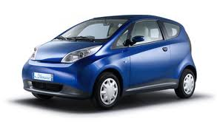
Driving Range
• 60 kg of Co° (or Co + Ni/Mn)
• 40 kg of Cu°
• 7 kg of Li°
Li-ion = 150 km
Nissan Leaf
• 70 kg of Fe°
• 10 kg of Cu°
• 10 kg of Li°
Lithium metal / polymer = 250 km
http://www.autolib.eu/
Taxi on average ∀ country ≈ 230 Km/day

Slide 13
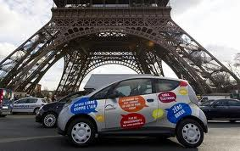
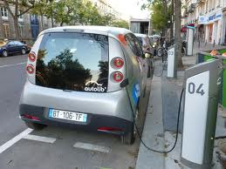
A Solid-State System in Not a View of the Mind
Autolib®:
2000 cars on a ”pay and ride”
basis
250 Km driving range
C/4 charge rate

Slide 14
T
> 220° Runaway!
180° Lithium melting
RUNAWAY !!
Electrolyte boiling
+80°C
Operation starting
+50°C
Liquid Electrolytes
Polymer Electrolytes
climate
Under the hood
- 20 °C Electrolyte freezing
-40°C

Slide 15


T
> 220° Runaway!
180° Lithium melting
RUNAWAY !!
Electrolyte boiling
+80°C
Operation starting
!
+50°C
Liquid Electrolytes
Polymer Electrolytes
climate
Under the hood
Lithium metal plating
- 20 °C Electrolyte freezing
-40°C

Slide 16
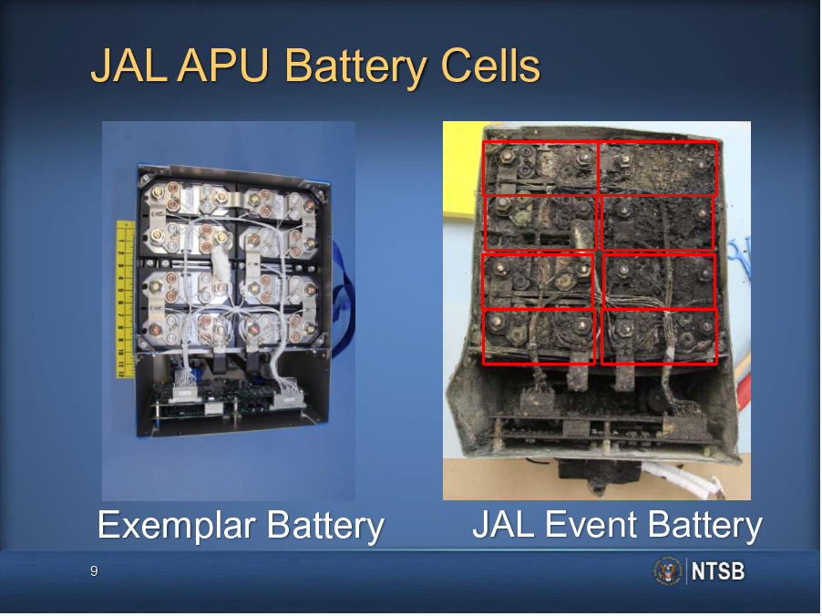
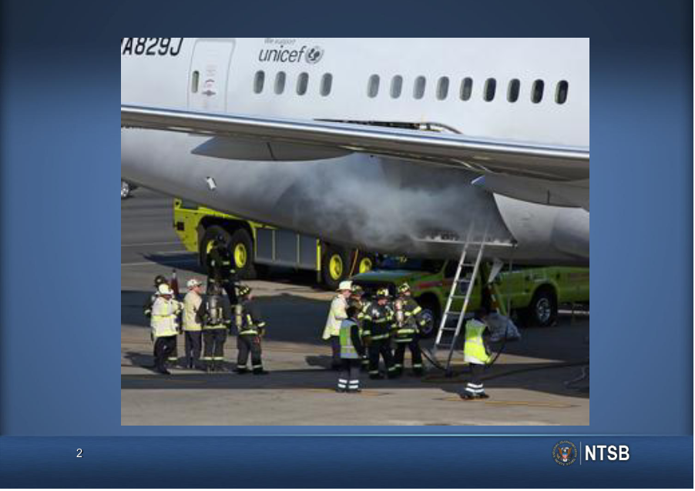
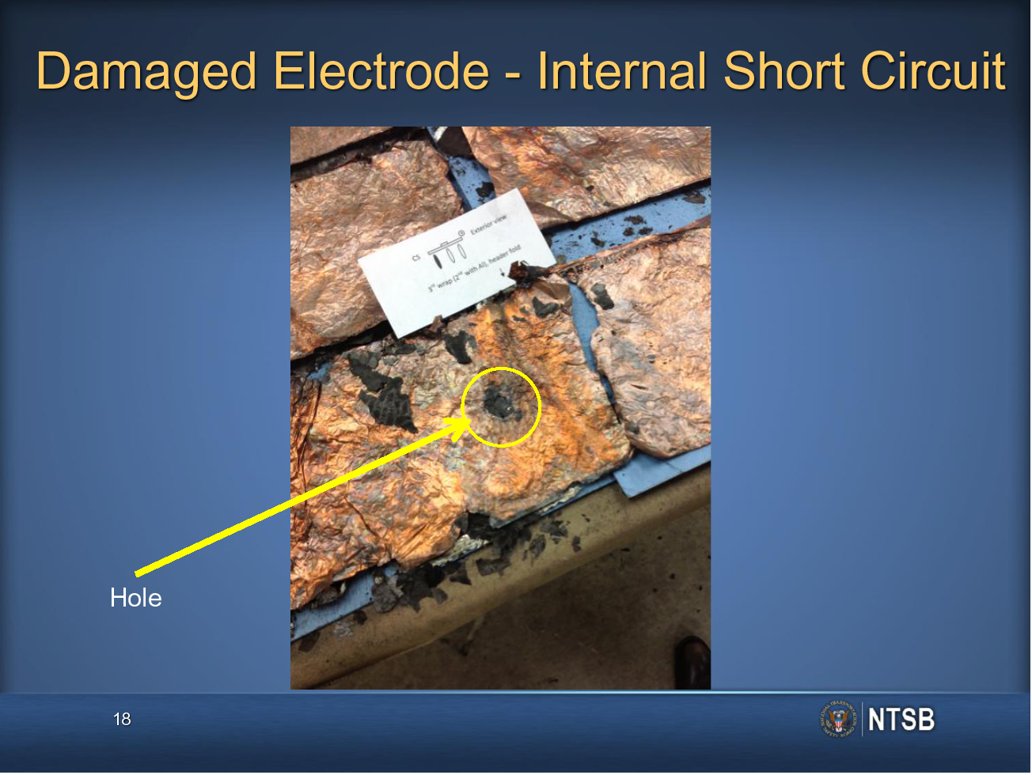
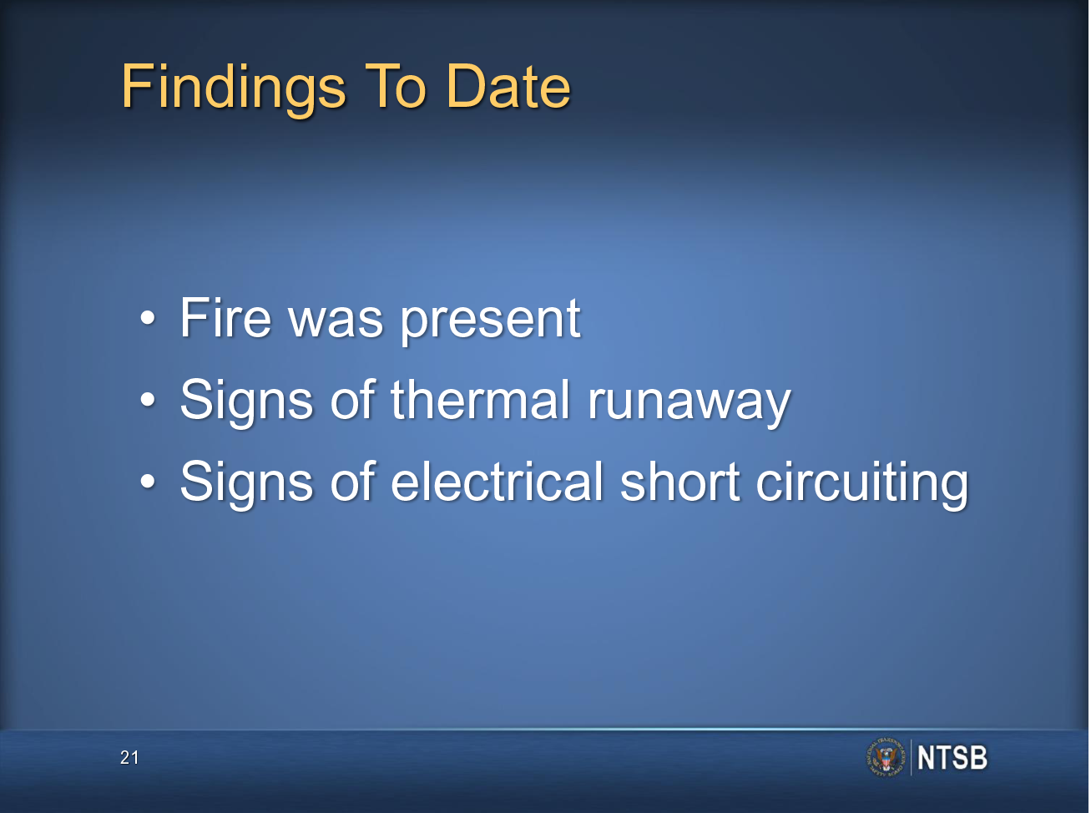
National transport Safety Board

Slide 17
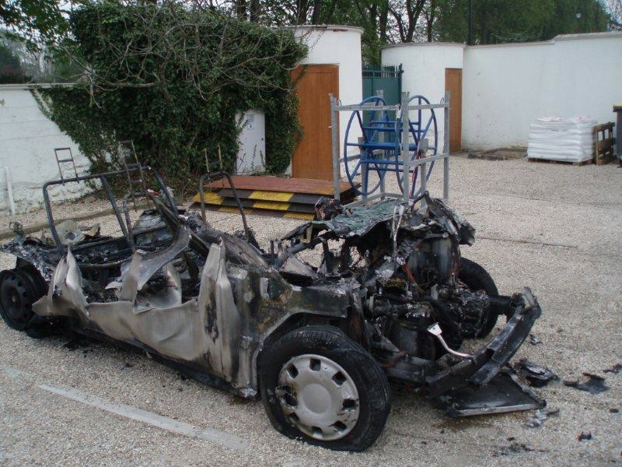
Safety again with solid electrolytes…
Courtesy Bolloré
5 autolib cars were torched in the Paris suburbs…

Slide 18
Towards 2 electrons / Transition Metal…
Potential vs. composition for the system
Li_{2-x}FeSiO_{4-y}N_{y} for y = 0.5 and y = 1
De Arroyo et al. J. Mat. Chem., 21(27), 10026 (2011).

Slide 19
t+ = 1 polymer electrolytes …

Slide 20
4 electrochemical contenders
Al current collector
Copper current collector
Very little metal used

Slide 21
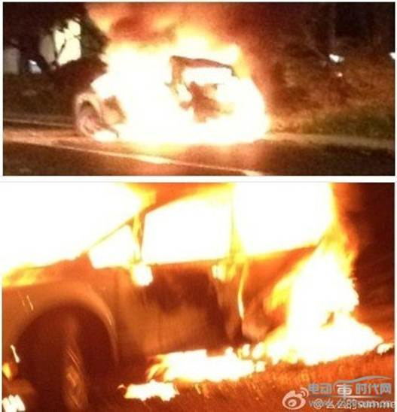
Conclusions…
• Batteries directly extrapolated from micro-electronics to Evs (even more grid!) are probably a dead-end due to unsustainability, short life-time and safety
• Li° polymer batteries DO exist with GREEN LiFePO₄ no Cu° and up to now meet SAFETY tests; a 60°C operation is a plausible and desirable goal. Probably not for grid.
• Focus on sodium-ion for smart grid storage. High temperature Na/S > 50 MWh installed
• Mg is a decisive advantage only if its double charge induces 2 electron reaction: MgMn^{II}SiO₄ ⇒ Mn^{IV}SiO₄ (cf LiFe^{II}PO₄ ⇒ Fe^{III}PO₄). But in limbos!
• Make all this electrochemistry as slurry to use in redox-flow cells. Decoupling capacity from size of the cell. Replacement of V^{V} + V^{IV} / V^{III} + V^{II} (20 Wh/kg)!

Slide 22
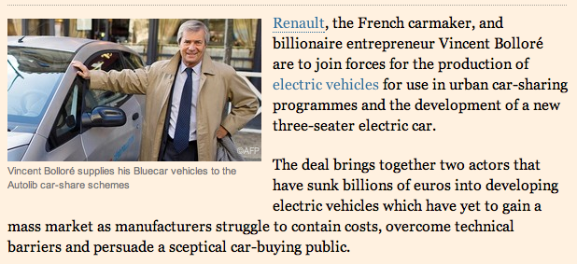
Renault and Bolloré in electric car deal
Sep 12, 2013
http://www.ft.com/intl/cms/s/0/49ca1de2-1bc8-11e3-94a3-00144feab7de.html

Slide 23
Thank you for your attention

Slide 24







A “Down to Earth” Approach to
Energy Density
Realistic charge
2 mAh/cm²
=
“Sand Charge” f(σ, t₊ D)
specific capacities
Composite?
Volume fractions
Composite:
Volume fractions

Slide 25
Why lithium?
Li⁺ is able to diffuse in most solid structures or cleave many metallic or ionocovalent bonds
Strong oxidizing agent
⇐ positive electrode
Oxides (lamellar)
Li_{x}CoO₂, Li_{x}V₂O₅ but 3D (LiMn₂O₄)
⇐ metallic Lithium
Strong reducing agent
⇐ negative electrode ⇒
Lithium intercalated in graphite ⇒

Slide 26
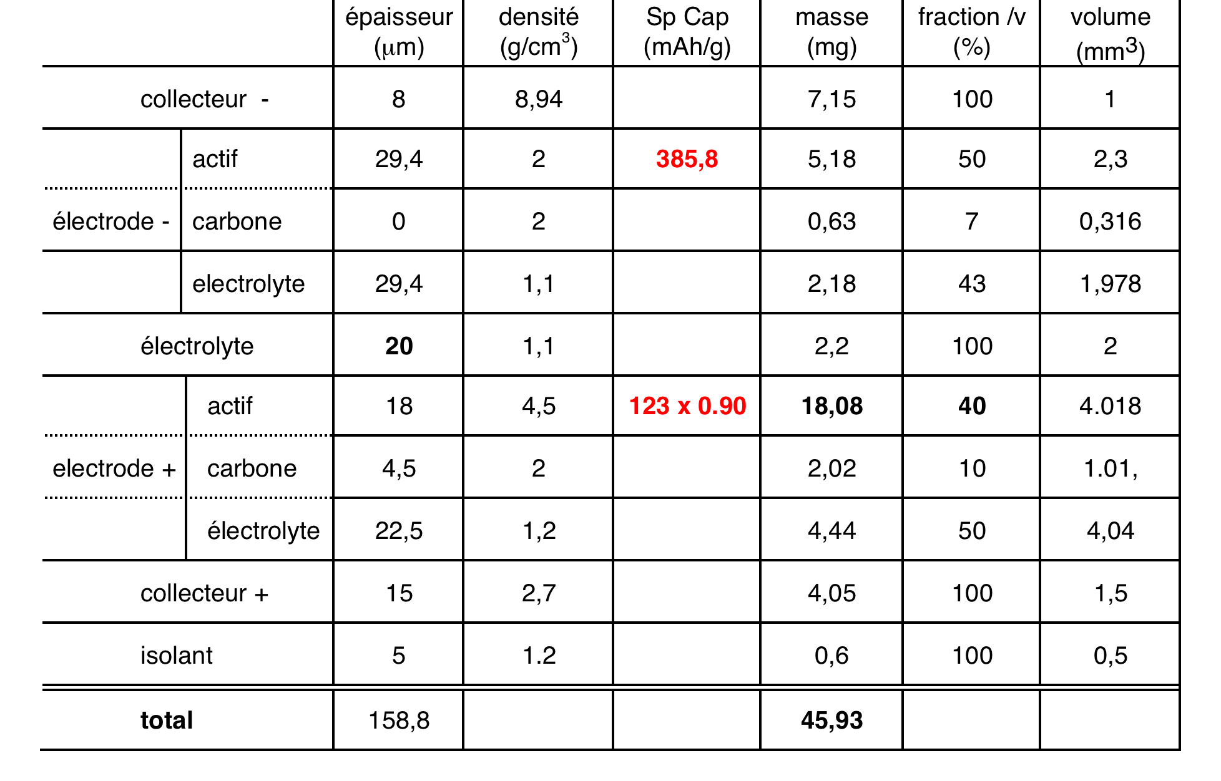
Classical LMNO li-ion …
LiC₆+ 1.25Li_{0.2}Mn₂O₄ C₆ + 1.25LiMn₂O₄
Si cathode @ 175 Wh /kg

Slide 27
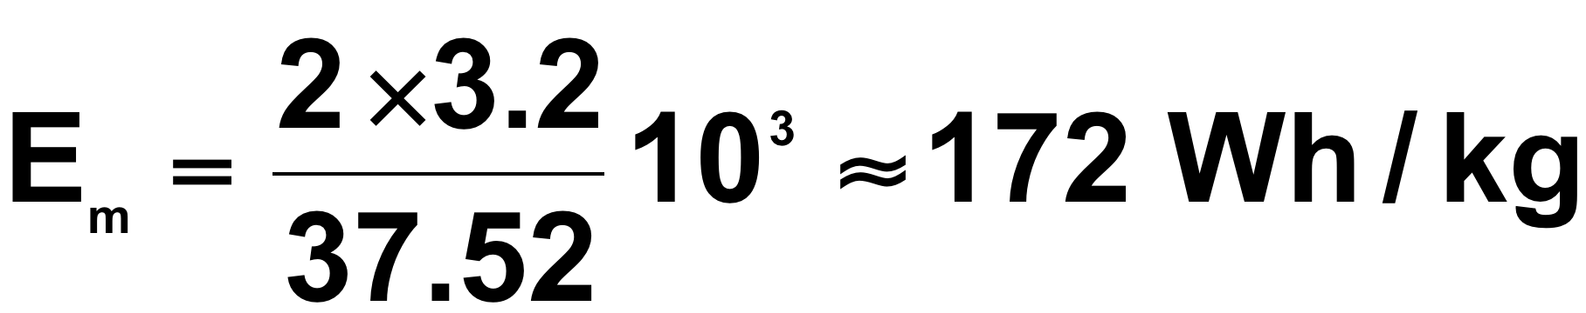
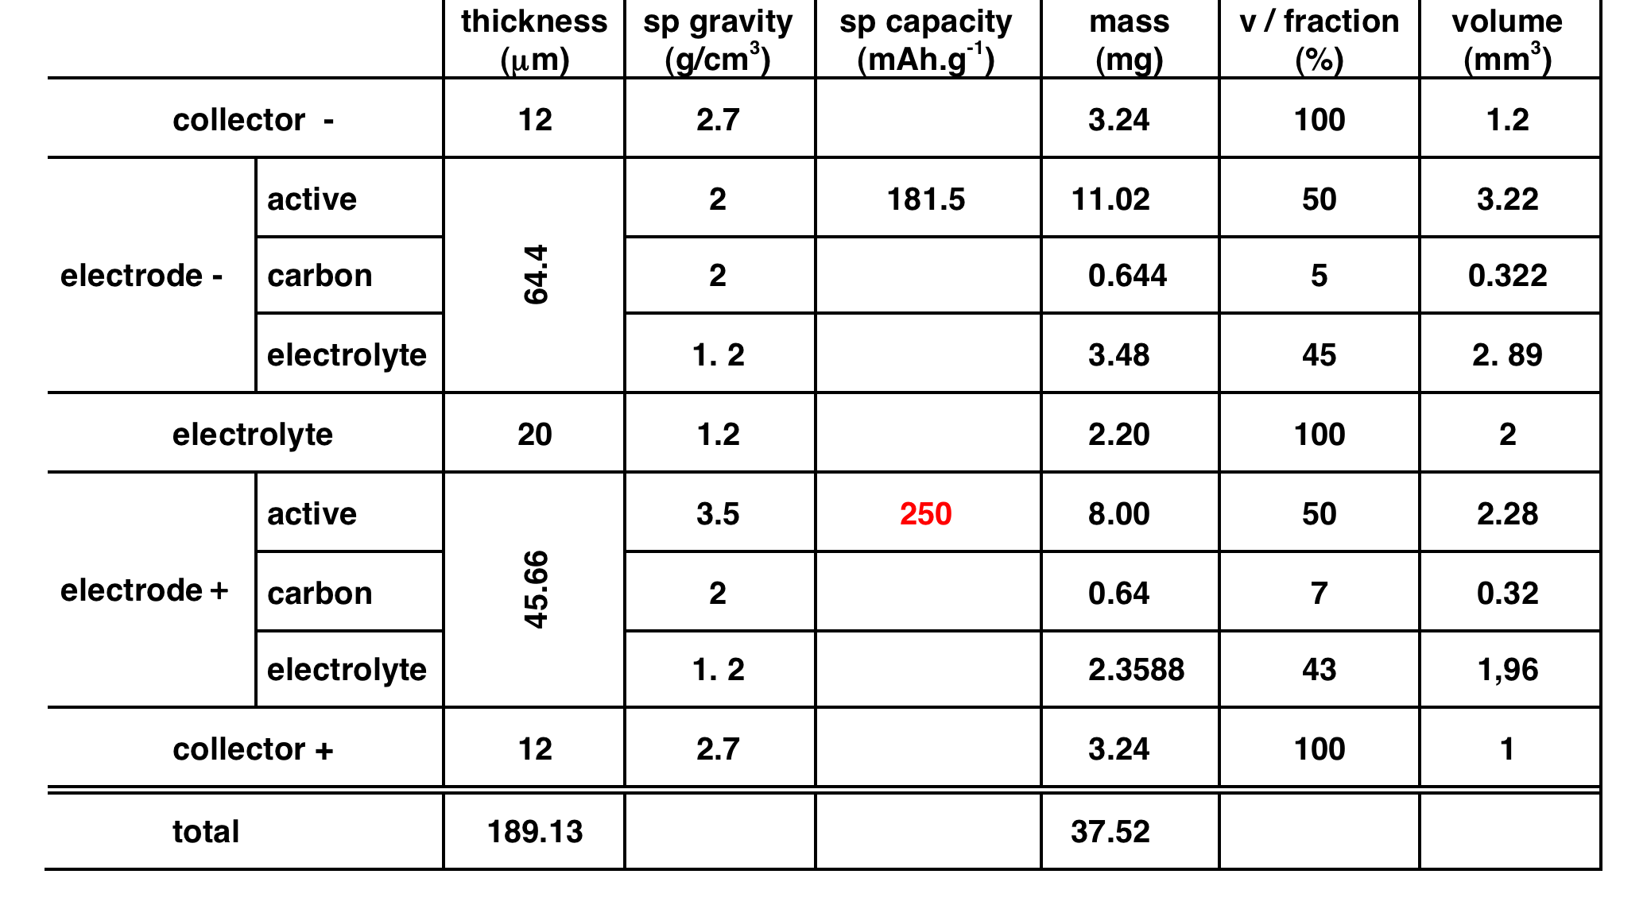
Lithium-rich cathodes System …
Li₄Ti₅O₁₂ +“Li-rich” Li₇Ti₅O₁₂ + ☐“Li-rich”

Slide 28
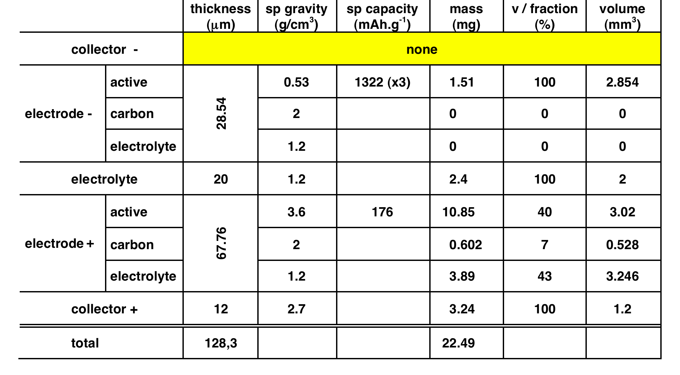
Lithium Metal System …
3Li + ☐FePO₄ 2Li + ☐LiFePO₄

Slide 29
Consequences of ambipolar Transport
X⁻
Li⁺
Li⁺
overconcentration
conductivity ⇓
X⁻
Li⁺
Newman’s model: t₊ = 1 are equivalent to
10 times more conductive t₊ ≈ 0.3 electrolytes
Dendrites Formation
Li⁺
depletion
conductivity ⇓ 0

Slide 30
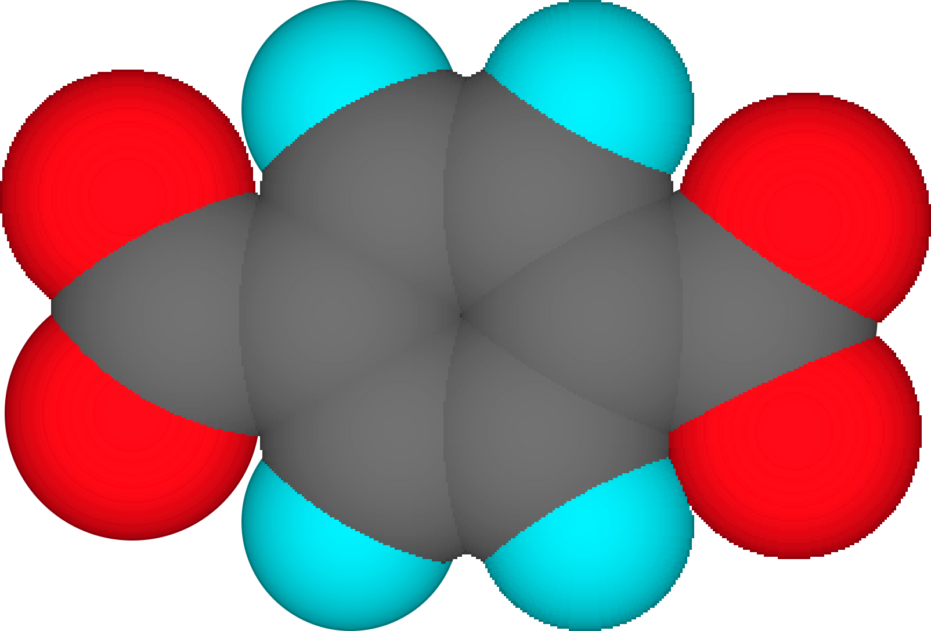
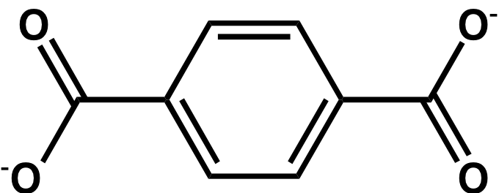
Composition-voltage behaviour of carboxylates
280mAh/g
35 000 T/yr available from PET recycling !
S. Grugeon, M. Armand, S. Laruelle, H. Vezin, P. Poizot and J.M. Tarascon (2008 Submitted

Slide 31
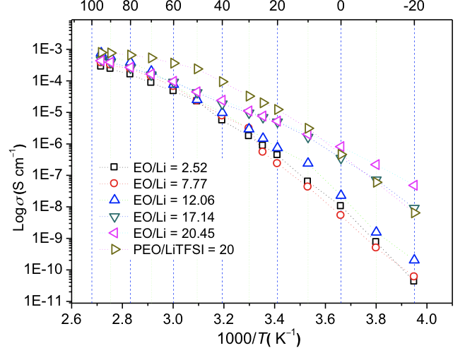
t₊ = 1 random polymer electrolytes …
Free anion state of the art

Slide 32
T₊ = 1 electrolytes
Nothing else but Li⁺ moves. Ultimate solution to no SEI, no concentration gradient.
But still needs @ 60°C operation
Newman’s modeling:
1/10th of the conductivity needed for the same power output than T₊ = 0.3

Slide 33
Classical LMNO li-ion …
LiC₆+ 1.25Li_{0.2}Mn₂O₄ C₆ + 1.25LiMn₂O₄
NEA: 33 % of
total weight
$ 5/m²
^{Si still ≈ 25%}

Slide 34
Fabrication process

Slide 35
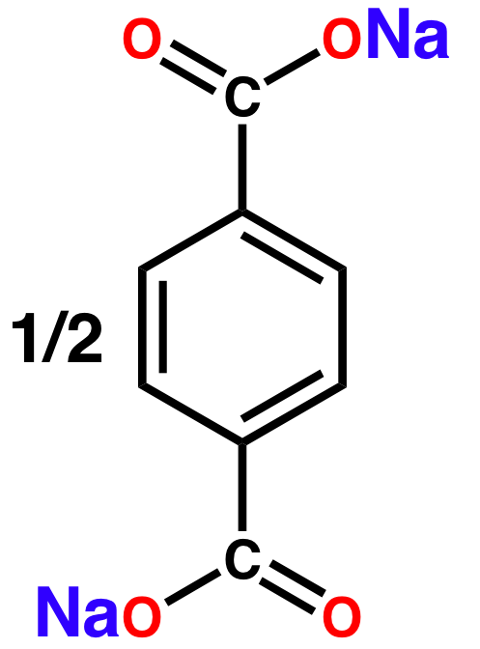
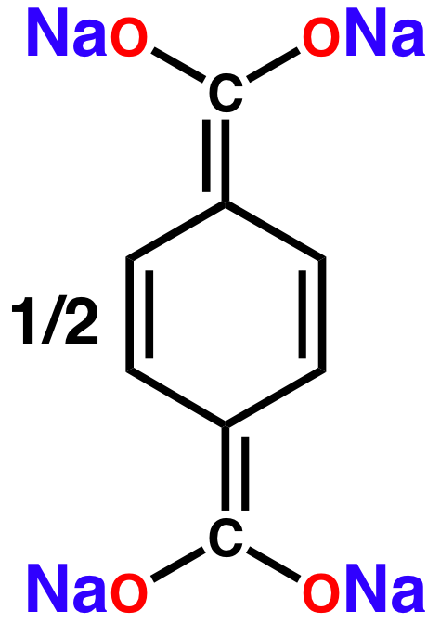
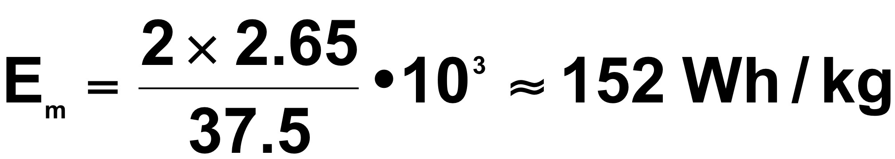
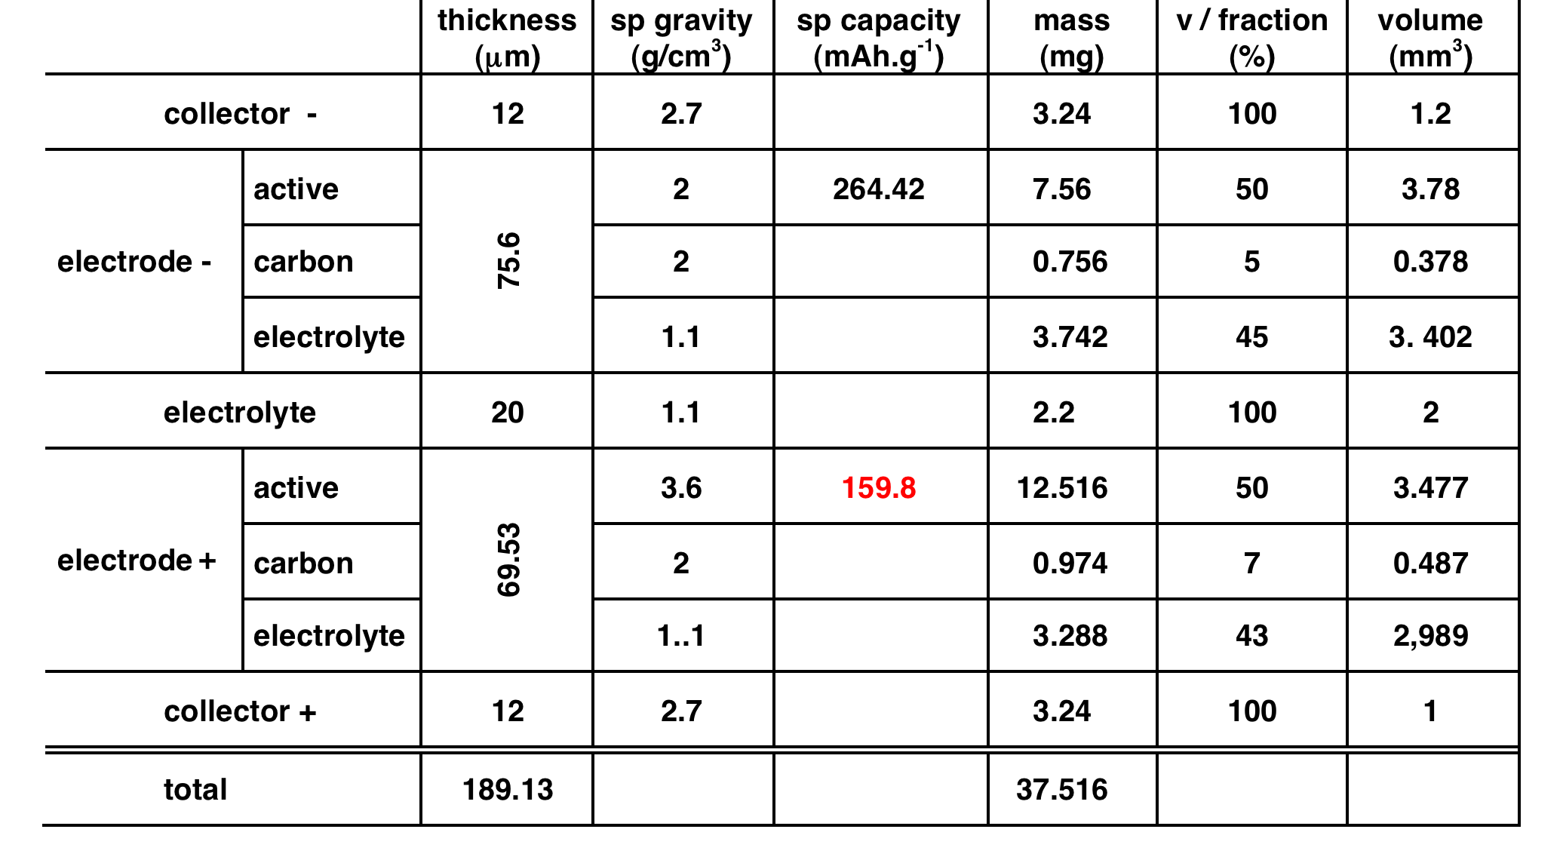
Sodium System…
+ NaFePO₄
+ ☐FePO₄
Liang Zhao , Junmei Zhao , Yong-Sheng Hu Hong Li , Zhibin Zhou , Michel Armand ,
and Liquan Chen Adv. Energy Mater. 2012,

Slide 36
Lithium Metal System …
3Li + ☐FePO₄ 2Li + LiFePO₄
7 % of
total weight
$ 1/m²
Li° = $ 70/kg

Slide 37
Safety!!
Shenzen, May 27 / 2012; 3 fatalities

Slide 38
Olivine structure
Triphylite
Heterosite
Properties

Thermal stability of LiFePO₄ and
FePO₄ phases up to 400 ºC
The “natural” intercalation compound a few billons years old!

Inexpensive material

Environmentally friendly
FePO₄
Li
J. Goodenough and K. Padhi, 1996

Slide 39
Electrode materials
Very poor e⁻ σ
1D ionic (poor)
3D Li⁺, e^{-,} semi-conductor
LiFePO₄
LiMn₂O₄
2008
Diminishing influence of σ electronic, dimensionality
1972-5
1984
1982
1995
Disulfides S—S
Discrete molecules
Intercalation
materials
Non-conductors
First biomimetic
reactions
Non-conductors
Radical species
2D semi-metal
TiS₂, graphite

Slide 40
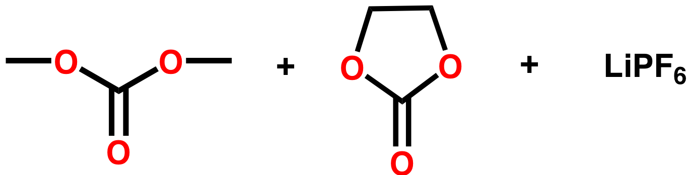
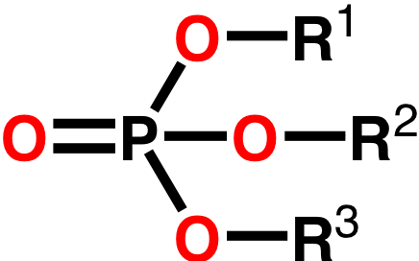
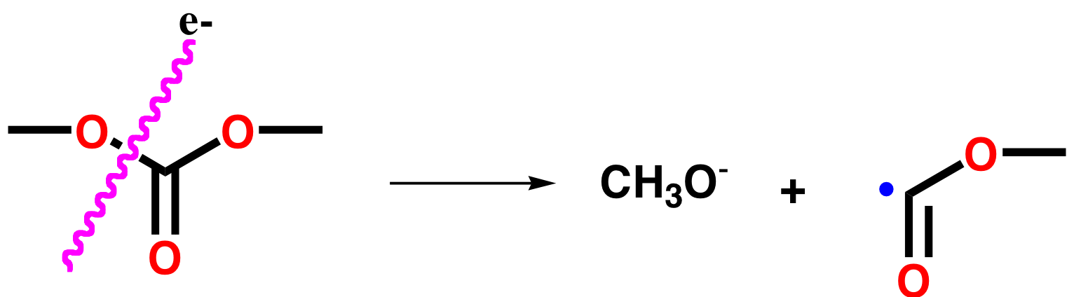
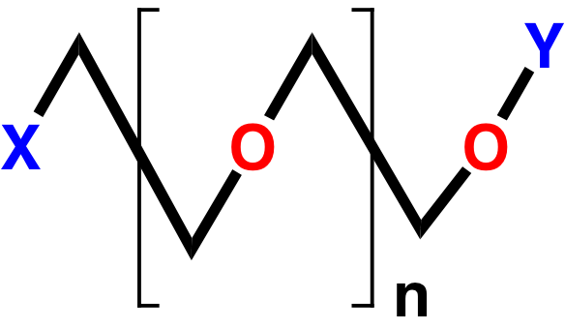
A chemical nightmarish cascade!
Aurbach et al.
Ogumi et al.
PF₅ + LiF
Urgent need to replace LiPF₆
+ H₂O ⇒ HF
!
X, Y, R¹⁻³ = H, Li, C(=O)OCH₃…
Oversimplification!
G. Gachot, S. Grugeon, M. Armand, S. Pilard, P. Guenot ,
J-M. Tarascon, S Laruelle. J. Power Sources 178-1, 409-421, (2008)

Slide 41
Nano-painting
Carbon coating ≈ 1nm thick, transparent to ions
Structured carbon black nano particles
Electrolyte

